Slide 1
IndieLite
Switching Credit Card Processor
Wednesday, April 21, 2021
Presented by
Geetha Nathan, IndieCommerce Senior Manager

Slide 2
Housekeeping
All attendees are in ‘Listen Only’ mode
We welcome questions and comments. Type them into the questions panel
Questions will be answered during and at the end of the presentation
Webinar recording and deck will be shared with the attendees
Use the hand icon for any technical issues
Trouble with audio? You can dial in by phone and watch on the computer screen

Slide 3
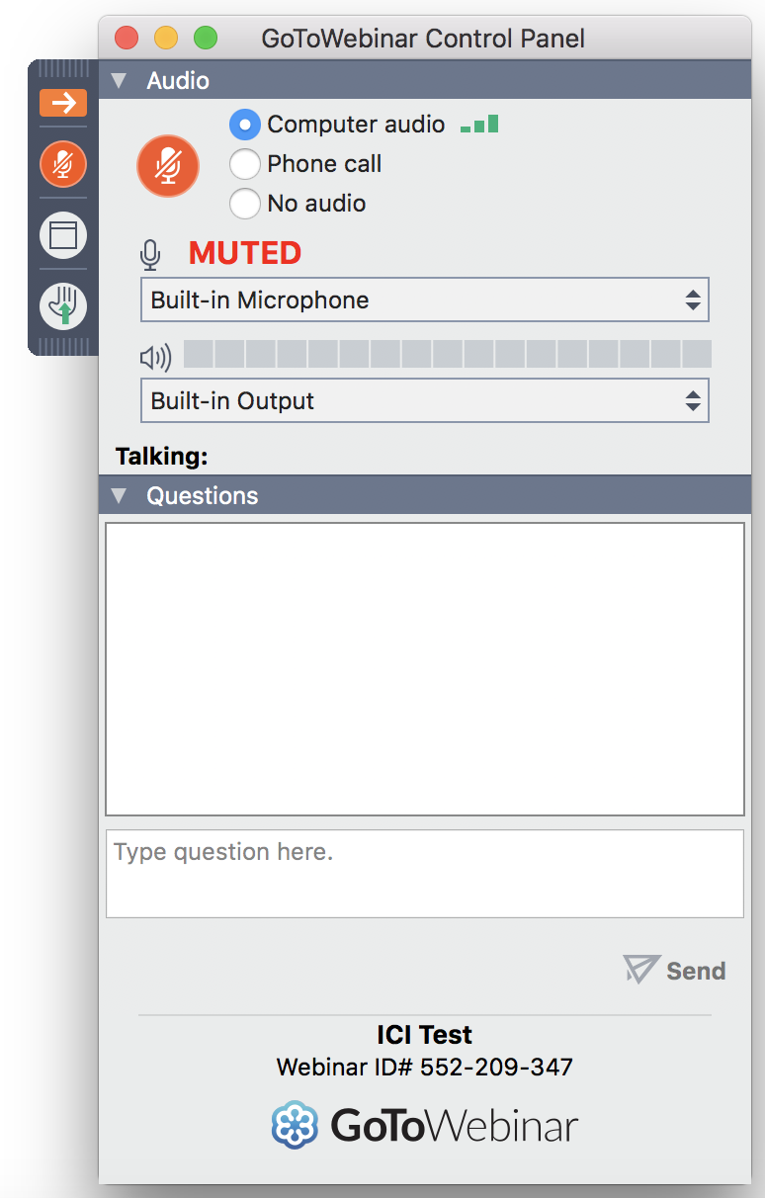
Hand Icon
Questions Pane

Slide 4
Who is this webinar for?
All IndieLite stores
Part 1 of a 2 part webinar series on this topic
Prepare for the transition to your own credit card processor
Create and configure your Authorize.net account
Part 2 - Focus on new features and order processing

Slide 5
Why is this important?
Manage all credit card transactions
Earn customers’ trust
Issue refunds easily
Process partial charges and refunds
Edit ‘Payment Received’ and ‘Completed’ orders
Save a reference to the customer’s credit card profile
Easier to process pre-orders
See store name on customer’s credit card statement
Get paid the same day
Complete control over your online orders

Slide 6
When should you start the process?
Now (as soon as possible)
IndieCommerce staff are standing by to help
Deadline : Friday, July 30, 2021

Slide 7
Payment Processor, Payment Gateway & Authorize.net
Payment Processor - Financial institution or bank used by a merchant specifically for collecting payments from credit card transactions, both in-store and online (Gravity Payments, Chosen Payments etc.)
Payment Gateway - Infrastructure that makes it possible for merchants to collect payments from websites, a ‘gateway’ between your website and payment processor
Authorize.net - Payment gateway supported on IndieCommerce and IndieLite websites
Notes:
There are 3 terms we use repeatedly when we discuss credit card processing. Let’s start with those.
Merchant Account - Almost everyone will already have a merchant account for in-store cc sales
Payment gateway
Authnet - only payment gateway we currently support on IndieCommerce

Slide 8
Core Components - Online Credit Card Transactions
Payment Processor
IndieLite Website
1
2
4
3
Payment Gateway
Notes:
This is a visual representation of how your IndieCommerce website, Authorize.net and the customer’s bank work together.
Customers places an order on your IC site
The order information and cc information are sent to Authorize.net
Authorize.net validates a few things about the order and customer’s cc, even before contacting the customer’s bank. For example - if the cc number is valid, If the customer’s IP is blocked etc. If the validation fails, your website customer will see an error message
When the first set of validations are successful, the transaction is sent to the customer’s bank. Customer’s bank validates the card, makes sure the customer has enough funds and sends a response back to Authorize.net
Authorize.net will check this response with your fraud protection settings and decide whether to approve the authorization or decline it
If approved, your website customer will be able to finish placing the order. If declined, your customer will see an error message

Slide 9
What are the necessary steps?

Slide 10
1. Payment Processor (Merchant Service Provider)
Do you already have a Payment Processor or Merchant Service Provider?
Do they work with Authorize.net?
Can they process all 4 major card types for online orders?
Sign up with a new Payment Processor
Should work with Authorize.net, process all 4 card types
Gravity Payments - Partnering with ABA
Pre-negotiated rate : 2.4% & 23 cents per transaction (no set-up costs)
https://gravitypayments.com/partner/aba-gravity-instant/
Jason Butler - jbutler@gravitypayments.com - 206-388-5900 ext 563
Nicole West - nwest@gravitypayments.com - 206-388-5900 ext 554
Notes:
If you already have a merchant account for your in-store sales, you may be able to use that same account for your website. Check…
If you don’t have a merchant account, or if you are shopping around for one with a good rate.. There are other options. Again make sure they work with Authorize.net and can process the 4 major card types.
Gravity Payments has been vetted by ABA for IndieCommerce websites, for online transactions.
There is a pre-negotiated rate.

Slide 11
Payment Processor - Requirements
On your website -
Terms & Conditions
Privacy Policy
Return / Refund Policy
Shipping Policy
Contact Information / “Contact Us”
Notes:
All Merchant account providers will expect to see these on your IC website - it is a requirement. So, it is better to have these pages ready before contacting your merchant service provider. We have boilerplates which you can customize to fit your store. If you need them, we can make it available with our help documents.

Slide 12
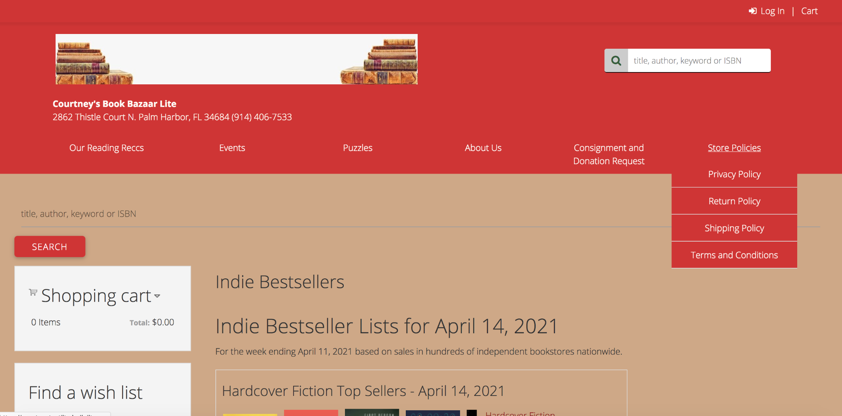
Privacy Pages -> Site Menu
Notes:
You can create those 5 pages on your website and provide links to them either in the footer region (if your site has a footer) or in the top menu. When you contact your merchant service provider, please let them know that this information is available on your site and provide them with links. The more prepared you are, the faster the process will be

Slide 13
Privacy Pages -> Site Footer
Notes:
You can create those 5 pages on your website and provide links to them either in the footer region (if your site has a footer) or in the top menu. When you contact your merchant service provider, please let them know that this information is available on your site and provide them with links. The more prepared you are, the faster the process will be

Slide 14
2. Authorize.net Account
Check with your merchant service provider
Or, if using Gravity Payments, it is included
Or, https://www.authorize.net/sign-up/pricing/
2 must-have features (Free)
Customer Information Manager (CIM) - manage customer profiles
Advanced Fraud Detection Suite (AFDS) - configurable fraud filters
Optional feature
Automated Recurring Billing (ARB)
Activate
Reset and use strong passwords
User Accounts
Roles and Permissions
https://account.authorize.net/help/Account/User_Administration/User_Role_Definitions.htm
Notes:
Your merchant service provider can create your Authorize.net account for you and also get it at a discounted rate. So, please first check with them first. Or, you can create one directly from Authorize.net.
CIM - With this feature, customers can save their credit card profiles for future orders. Nothing is saved on your website or on our IC platform. The senstive information is saved on Authorize.net’s secure servers, thereby simplifying PCI compliance.
AFDS - There are about 13 configurable fraud filters to help you identify, manage and prevent fraudulent transactions. We will go over them.
ARB - This will be useful if you have subscription programs
Activate - As soon as an account is created, you would receive an email from Authnet to activate your account. Please also remember to change your password and use a strong password
User accounts - There are different user roles in Authorize.net - Administrator, transaction manager etc.. If other store staff should have access to your Authorize.net account, you can create their accounts for particular roles, depending on what they will be doing on the site.

Slide 15
3. Configure your Authorize.net Account - Checklist
Account Owner Profile - Change password and check profile
User Administration - Create additional accounts
Payment processor information
Customer Information Manager - Confirm this is enabled
Advanced Fraud Detection Suite settings
https://www.bookweb.org/indiecommerce/authorizenet
‘Fraud Detection Suite Settings 2019.pdf’
Payment Form -> Form Fields -> None of the fields should be ‘Required’
Fraud Email Notifications
Set to ‘Live’ mode
Notes:
A checklist for your Authnet account.
Go over the account profile and confirm the settings
User roles. Make sure your staff understand the permissions their roles have
CIM - Make sure this feature is enabled, if not, please enable it
AFDS - In the IC help documents you can find a pdf of our recommendations. I will go over a few of those settings here
Payment Form - this is an important setting
Fraud Email Notifications - this goes with the fraud filters. For certain fraud filters, you can allow the authorization to go through but have an email sent to you as an FYI, so you can check it.
For example, there is a filter for transaction amount. You could set the limit to $100. If the order total is more than $100, you can configure that filter to process that transaction, but email you as well. You can then check the order on your site and confirm that it is not a fraud order.
Set your Authnet account to LIVE mode.

Slide 16
Authorize.net
Over to a Sandbox Account...
Notes:
Let’s take a look at some of the Authorize.net fraud filter settings

Slide 17
Authorize.net
Advanced Fraud Detection Suite
Notes:
Let’s take a look at some of the Authorize.net fraud filter settings

Slide 18
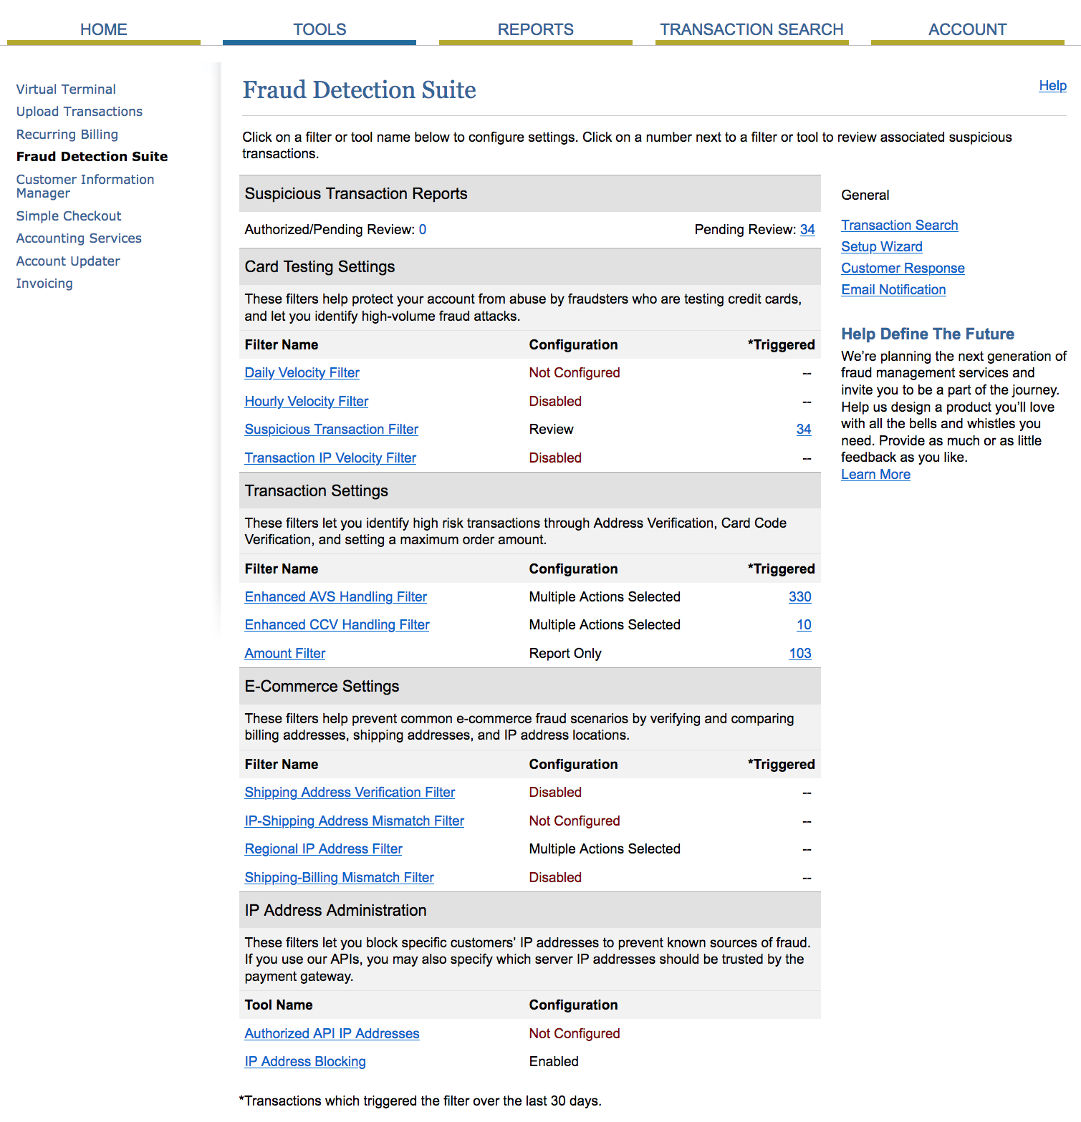
Notes:
This is the main Fraud Detection Suite page. This is actually from our Authnet account.
You can see that we have some of the filters disabled, that is just our choice. You can enable them if you want to.
The numbers next to some of the filters represent the number of transactions that triggered that particular filter, and these numbers are for the last 30 days.
You can see that the Enhanced AVS filter was triggered more than 4000 times in the last 30 days. These numbers are high in our account because several thousands or transactions go through ours. Your would be proportionate to your online transactions,.
For the first couple of months it would be a good idea for you to keep an eye on your Authorize.net account, check which filters are being triggered, are they false positives etc. It would help you tweak the filter settings
The Email Notifications is where you would set who should get notified for suspicious transactions

Slide 19
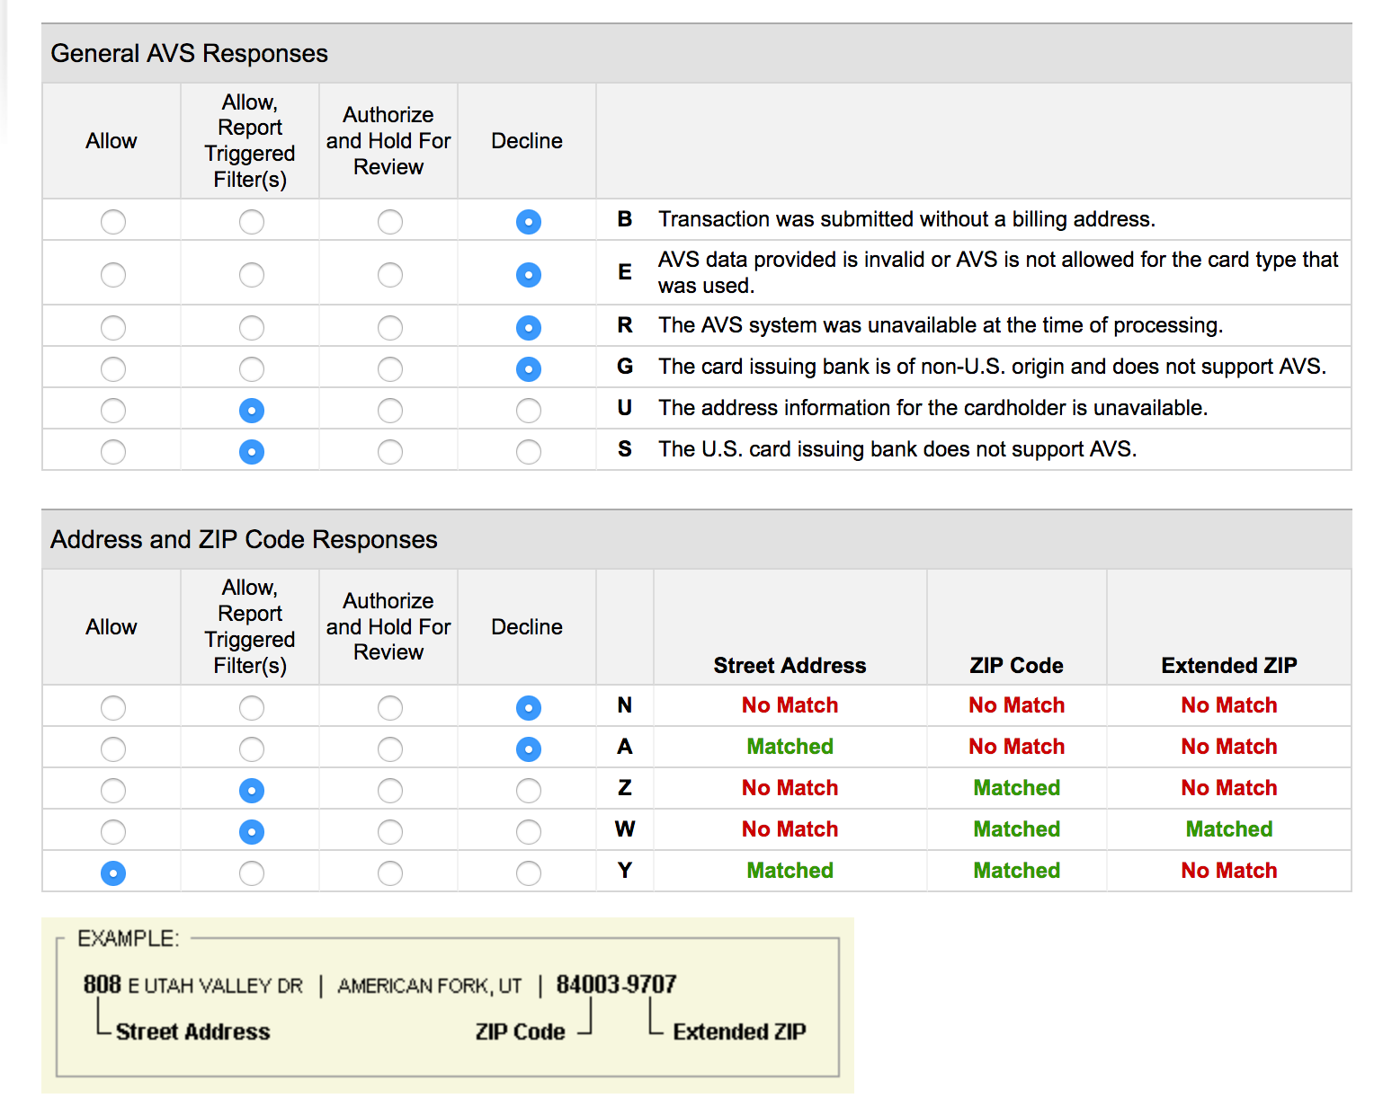
DON’T USE
Notes:
Address Verification - This is where the customer’s address on the cc is compared with the billing address on the order, this is one of most frequently triggered filter.
The settings here are our recommendations.
Important to note - Never set any filter to ‘Hold for review’. It would mean that Authorize.net is waiting for you to approve a transaction, while your customer would see an error during checkout. Later, even if you were to approve a transaction, that is not conveyed back to your IC site. So, don’t set any filter to ‘review’
For the Address and ZIP code checks, more emphasis is given to the zipcode. If that is not a match, the authorization is declined.

Slide 20
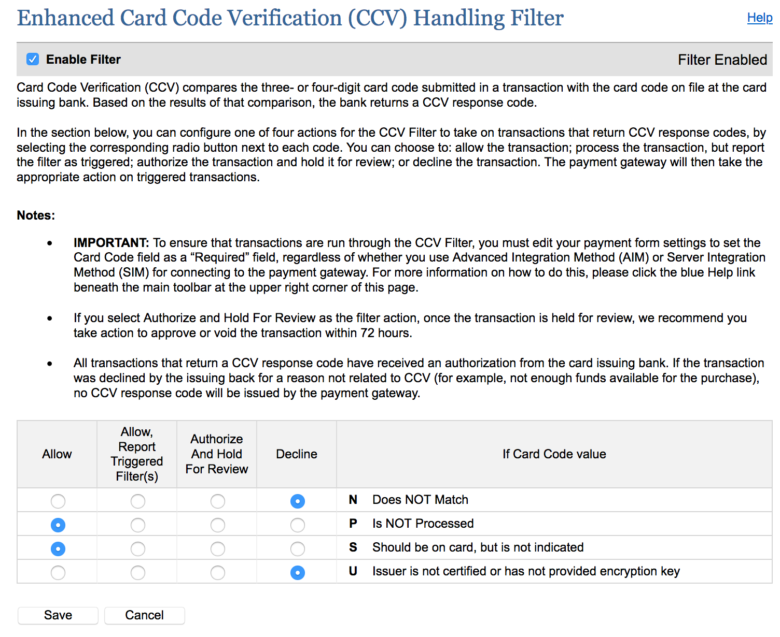
Notes:
The is the card verification code, it is 3 digits for V, M and D and 4 digits for AMEX
Some of the gift credit cards may not have a cvv code, so we allow two of those responses

Slide 21
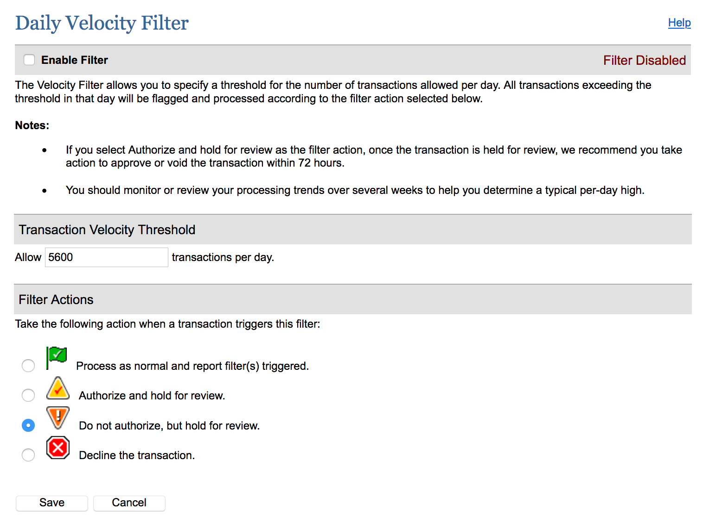
Notes:
This is one of the filters that we have not enabled, and is probably not included in our recommendations.
But, you can enable it for your account. It puts a limit on the number of transactions per day. If you decide to enable this, you could set it to ‘Process and report filter triggered’..so the transactions are not blocked but will be flagged and you can check it

Slide 22
Notes:
This filter checks the number of transactions per hour. Please do not set any of these to hold for review

Slide 23
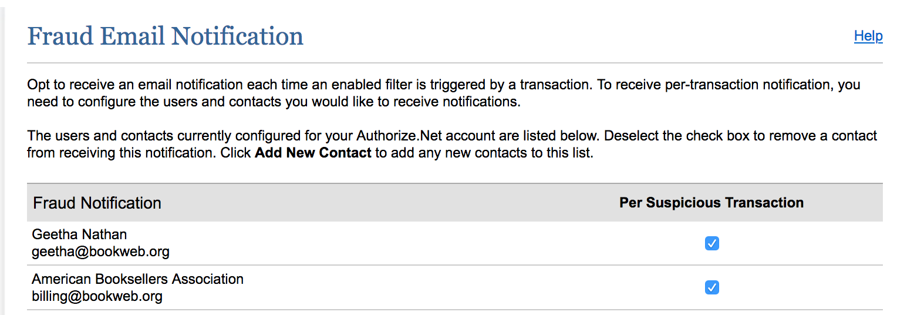
Notes:
This is the page where you would set the emails to receive notifications from Authnet about suspicious transactions. It is good practice to check your authnet account periodically for any suspicious transaction flags

Slide 24
4. Generate Authorize.net ‘Keys’ For IndieLite
API Login ID, Transaction Key & Public Client Key
Establish connection between your website and Authorize.net
https://account.authorize.net/helpCP/Account/Settings/Security_Settings/General_Settings/API_Login_ID_and_Transaction_Key.htm
Please DO NOT email these to the IndieCommerce team
Submit the ‘keys’ on your IndieLite website
Store -> Configuration -> Account Information and Preferences -> Store Authorizenet
DO NOT send us your Authorize.net login information
Login to your IndieLite site before generating the keys
Notes:
Now .. your Authnet account is ready. The next step is for you to share with us the information we need to make the changes on your IC site. You can wait until you are ready to make the transition to send us the information.

Slide 25
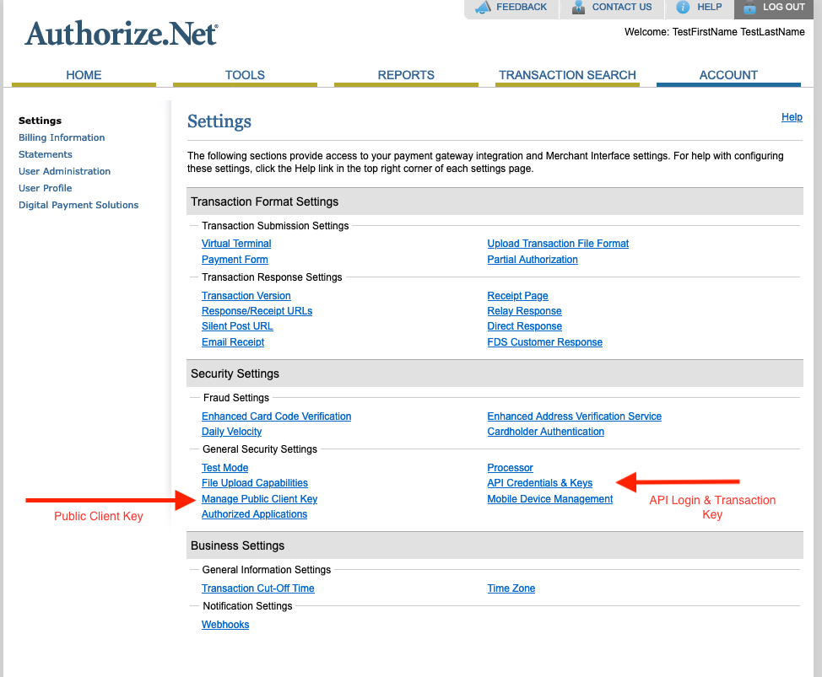
Notes:
When you login to your Authnet account, go to the Settings page.
API Login is like a username, you create it once and it doesn’t change
TransactionKey is like the password. Once to generate it, you have to save it and send it to us. After that you cannot see it on your Authnet account. Don’t regenerate the transaction key, there should be no reason to regenerate it. But if you do … for some reason… you have to let us know so we can change it on your IC site
Once you generate your public client key, it will visible

Slide 26
Authorize.net Account - It is yours!
It is your account
Learn to manage it
Tools and Reports
Announcements
Scheduled Maintenance
Follow on Twitter
Support - Phone or Chat
Notes:
Even if the account was created by your merchant service provider, Chosen or Gravity or anyone else… they are only helping you create this account. It is YOUR account. You should know how to access it, manage it etc.
Any questions about your Authorize.net account, please ask Authnet. We have used them for almost 11 years now and I find their customer support pretty good. I always use their online chat service, that works for me

Slide 27
Advantages
No need to wait for ABA to transfer funds for online sales
Have your store name on the customer’s credit card statement, instead of ‘INDEPENDENT BOOKSTORE’ (which is currently confusing to customers)
Choose fraud protection settings you are comfortable with
Better credit card fees
Authorize.net Verified Merchant Seal - Increase customer confidence, increase online sales
https://support.authorize.net/s/article/Authorize-Net-Verified-Merchant-Seal-How-It-Works-Configuration
More control over online credit card transactions
Refund customers directly from your IndieLite website
Notes:
There are several advantages in having your own credit card processor - gives you more control over your online credit card orders, and your finances

Slide 28
5. Prepare for the transition
Process open credit card orders - regular and pre-orders
Mark orders as Payment Received or Completed
Or, mark them as Canceled
Stop Ingram orders a week before the switch-over date
Schedule a date and time
Turn off Credit Card payment the night before
Set your Authorize.net account “Live”

Slide 29
6. On the day of the switch over
Post a message on the website to let your customers know, provide alternate payment methods
Be available by phone / email to coordinate with the IndieCommerce team member
Be ready to login to your Authorize.net account
Be ready to be your first ‘customer’ on your credit card processor
Only 15 mins, if no issues

Slide 30
Resources & Help Documents
Get Started - Checklist
Authorize.net Next Steps
Authorize.net Fraud Detection Filters
https://gravitypayments.com/partner/aba-gravity-instant/
https://www.termsandconditionsgenerator.com/
https://www.privacypolicygenerator.info/
https://www.volusion.com/tools/return-policy-generator
https://www.termsfeed.com/blog/sample-shipping-policy-template/#Download_Shipping_Policy_Template

Slide 31
Feedback from an IndieLite store
I had an initial phone appointment with Jason Butler that took about 10 minutes. He sent over some forms to be signed via docusign to set up the accounts. After that, I received an activation email from authorize.net with initial set up steps and also received from Jason further instructions which I followed and then contacted the IndieCommerce team. It went smoothly .

Slide 32
Questions?

Slide 33
Thank You!!

