Slide 1
Institutional Business with Schools and Non-Profits
Presented by: Finnigan Butterfield & Murray Sampson
Panelist: Kenny Brechner
Moderator: Geetha Nathan

Slide 2
Today’s Topics
Partnering with schools and non-profits to supply books to the community
Partnering with schools and non-profits to supply books to their institutions
Further connection with non-profits and the community

Slide 3
Partnering with Schools & Non-Profits for the Community
Ways to partner with schools or non-profits to get books into the hands of your community

Slide 4
Loyalty Memberships
IndieCommerce
Create custom role that gives a discount on all orders
Create a discount code that is sent to schools
Custom checkout pane to collect membership numbers for post-checkout
IndieLite
Create a discount code that is sent to schools
Book list for bookclubs with associated discount
Keep list of members for post-checkout

Slide 5
Bookfairs
Will you be crediting the school for purchases of any books, or do you wish to restrict it to specific titles?
Do you want to have teacher wishlists for parents to buy for their student’s classroom?
Do you need a way to quickly separate bookfair orders from regular orders?
How will you be getting these books to the students?

Slide 6
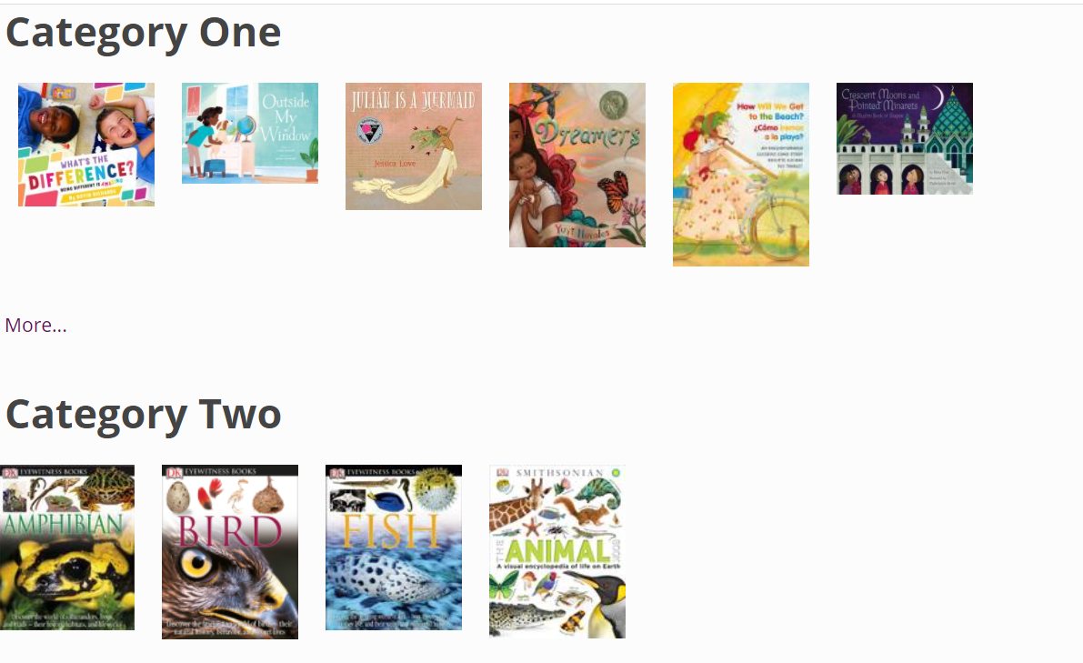

Slide 7
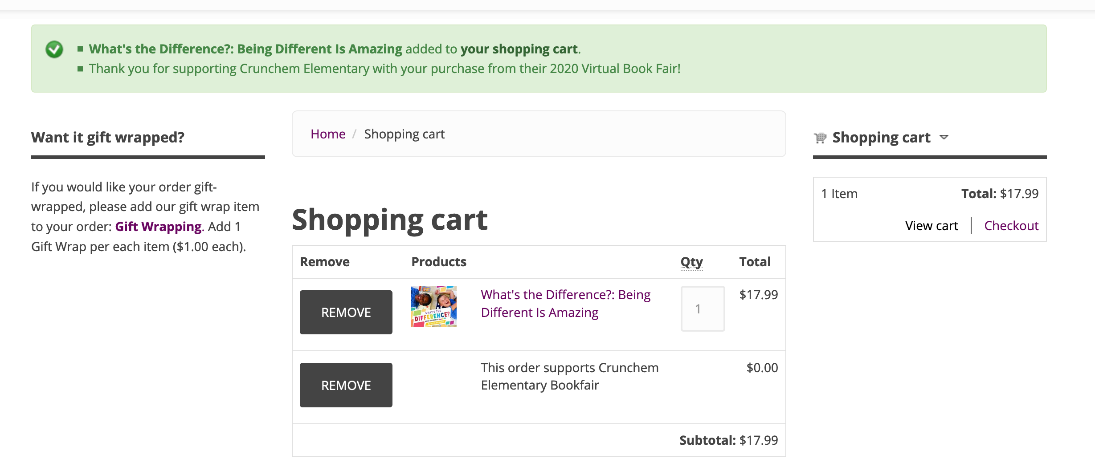

Slide 8
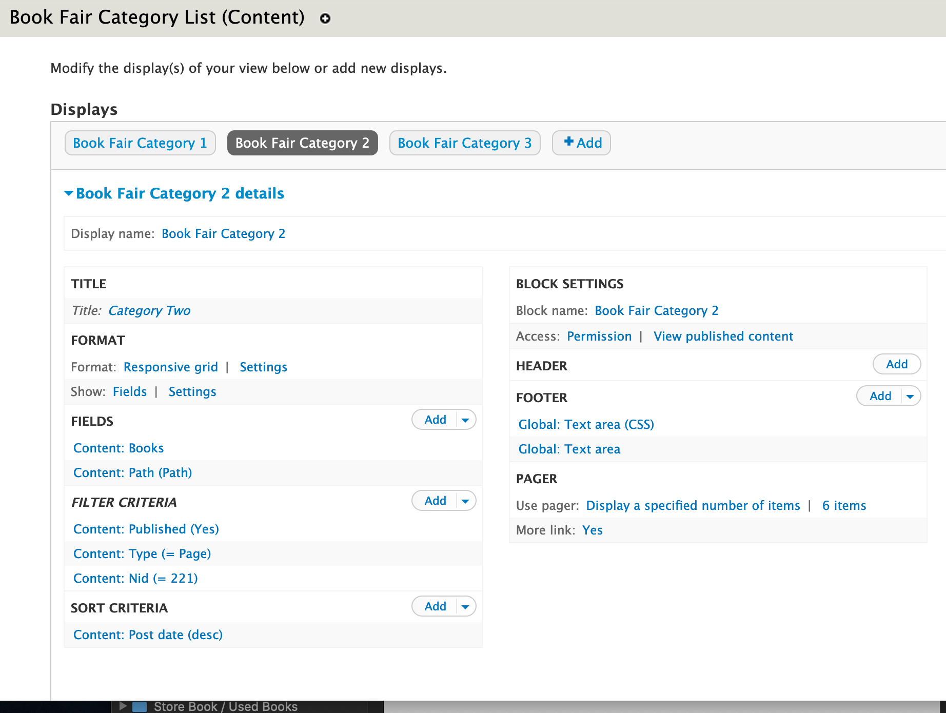

Slide 9
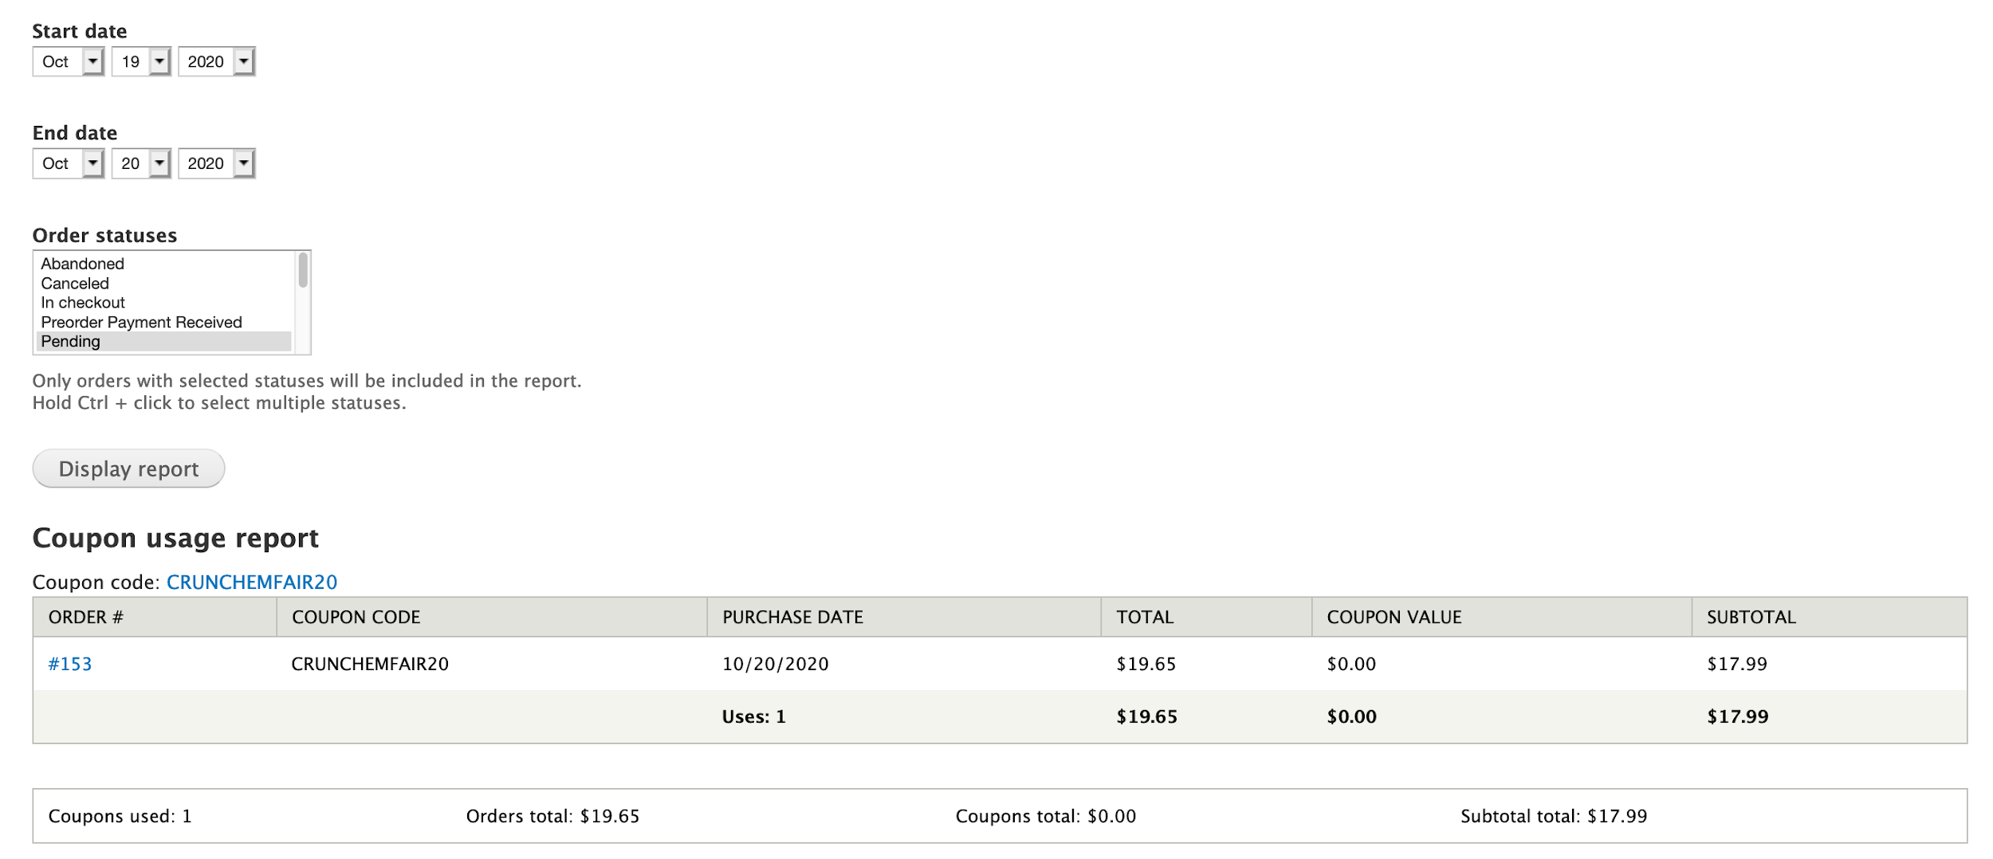

Slide 10
Abcfairs.com
Copperfair.com

Slide 11
Partnering with Schools & Non-Profits for Institutions
Ways to partner with schools or non-profits to get books for the institutions themselves.

Slide 12
Subscription Services
Supply books to classrooms and libraries in bulk
Discounted or fixed rate
Pay up front or monthly
Example: Ahead of the Curve from Devaney, Doak, & Garrett

Slide 13
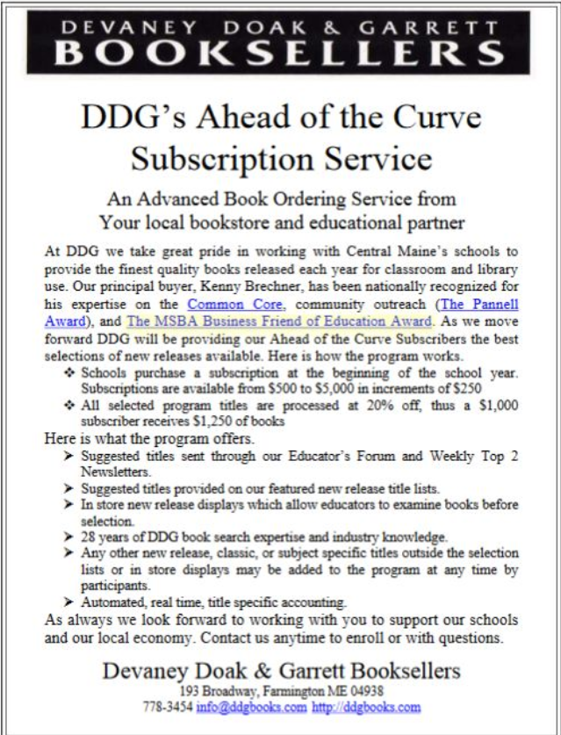
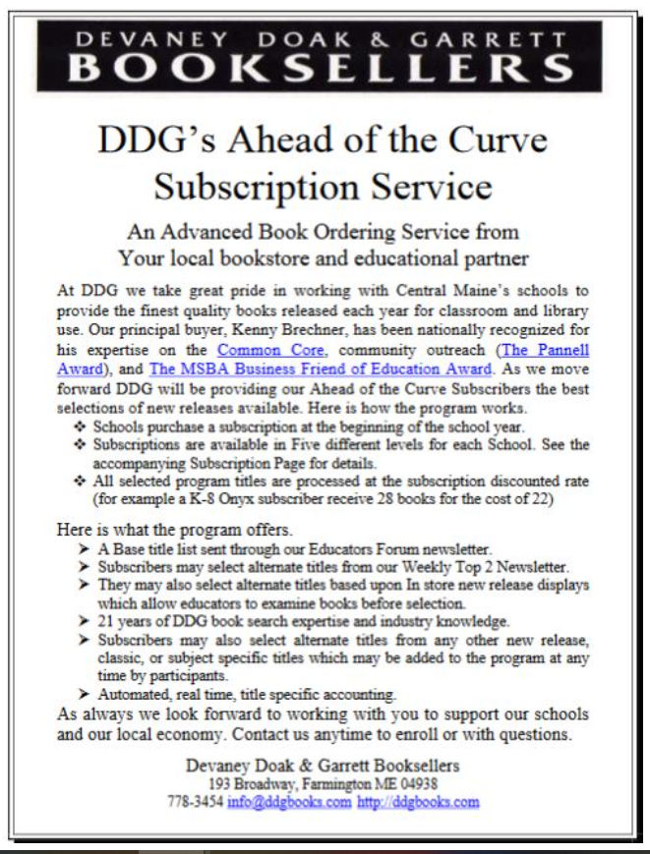

Slide 14
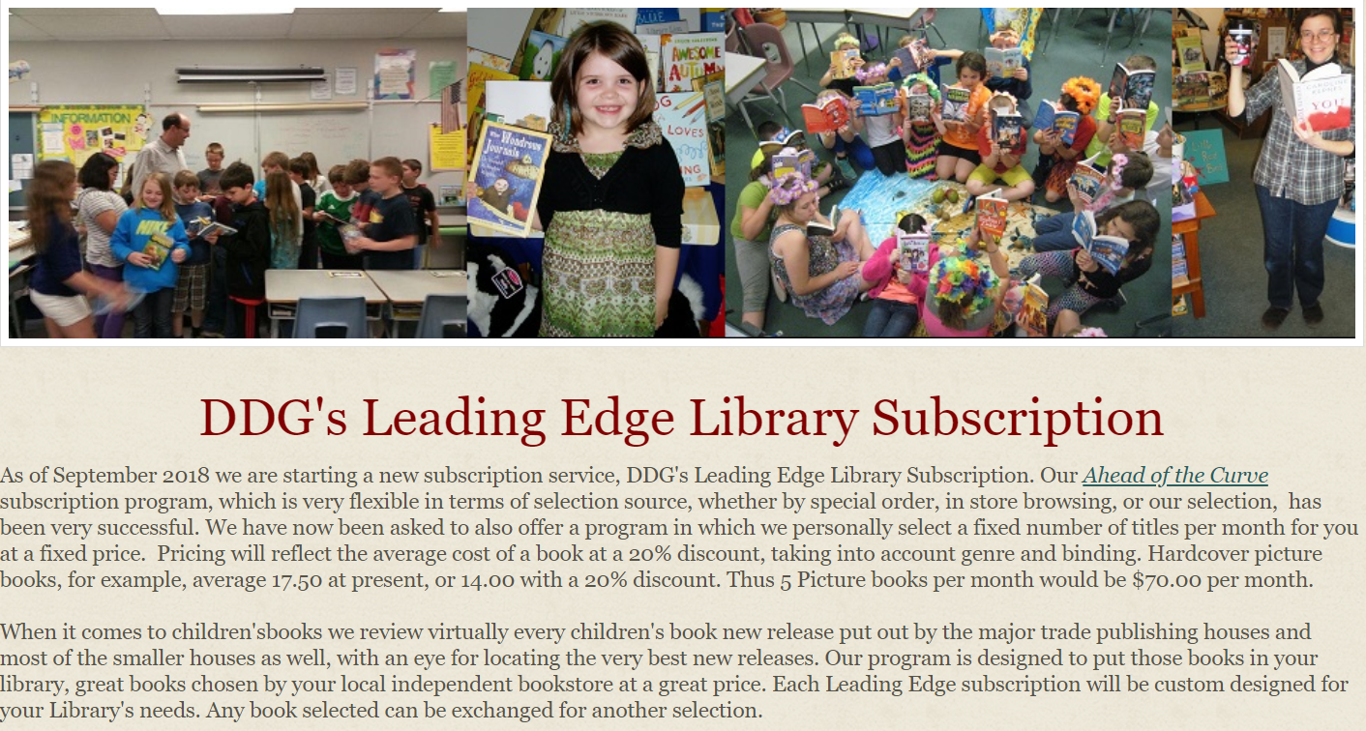

Slide 15
Subscription Service Products
IndieLite
Create a page that hosts all information on subscription services
Enter all information about these programs on the page & through images you upload to the page
Create a contact form for subscription service inquiries
IndieCommerce
Create your subscription services as custom product with whatever fields, description, price, and images you feel are appropriate
Charge customers for these services on a timed schedule using saved credit card profiles - although this cannot currently be automated, the order can be created on behalf of the customer each month

Slide 16
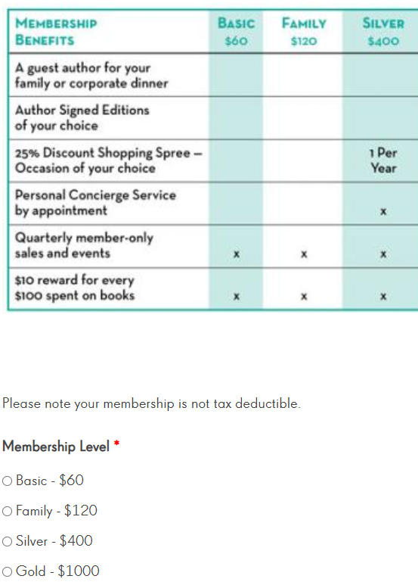
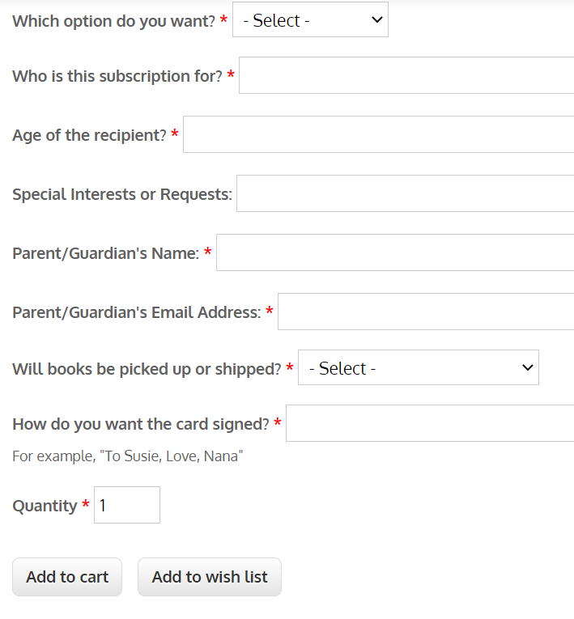
keplers.com/lit.circle
bookmarksnc.org/kidsclub

Slide 17
Further Connecting with Non-Profits & Community
These are ways you can further partner with non-profits to promote literacy while also connecting with the community they serve.

Slide 18
ARC & Book Reviews
ARCs & Galleys
Comments
Bring Books to Life
School Events (space and circumstances allowing)
Classroom Visits
School-specific author visits
Small events put on by the school

