Slide 1
Financial Modeling Workshop:
Learn How to Create a Financial Model to Analyze a
New Business Opportunity
Presented by: Dr. Peter Brous, Professor of Finance, Seattle University
Tuesday, Feb. 21 | Room 605-610 | 4:10 pm to 5:30 pm

Slide 2
Analyzing New Business Opportunities
Best Practices Suggest Applying Cost/Benefit Analysis:
1. Identify a New Business Opportunity
2. Collect/Estimate Relevant Data (Costs and Benefits)
3. Analyze the Relevant Data (Apply Cost/Benefit Analysis and Sensitivity Analysis)
4. Make the Investment Decision

Slide 3
Make the Investment Decision
The Investor’s Objective/Goal of the Investment is Key to the Decision to Invest.
Objective/Goal Could Include One or More of the Following:
Financial Value Impact (Cost/Benefit Analysis)
Social Value Impact
Personal Value Impact

Slide 4
Collect/Estimate the Relevant Data (Costs and Benefits)
Costs are the Upfront Costs Necessary to Start a New Business Opportunity such as: Build Out Cost (Renovations Necessary), New Equipment, First/Last Month’s Rent, Working Capital (Cash and Inventory), etc.
Benefits are the Impact on After-Tax Operating Profits (Increased Annual Revenues – Increased Annual Costs)
Abacus: Financial Benchmarking Report Provides Useful Data to Estimate Costs and Benefits

Slide 5
Abacus: Financial Benchmarking Report: Key Data for Forecasting Future Revenue
A Simple Approach to Forecasting Revenue is to Multiply the Store’s Useful Square Feet by the Expected Sales per Square Feet.
Based on the Data Provided on Page 31 of the Abacus, Average Sales per Square Feet in 2021 was $322, So If Your Store is 3,000 Square Feet then the Forecasted Sales = $322 * 3,000 = $966,000.

Slide 6
Abacus: Financial Benchmarking Report: Key Data for Forecasting Future Expenses
A Simple Approach to Forecasting Expenses is to Multiply the Expense as a % of Sales by Forecasted Sales.
Based on the Data Provided on Page 24 of the Abacus, Average Expenses per Sales in 2021 are Provided. For Example, Cost of Goods Sold as a % of Sales was 54.5%, So If Forecasted Sales is $966,000, Forecasted Cost of Goods Sold = 54.5% * $966,000 = $526,470.

Slide 7
Real World Example: Cost/Benefit Analysis for Opening A New Bookstore
I Was Provided A Bookstore Owner’s Forecasts for the Upfront Costs and the Future Benefits (Operating Profit) for the First Three Years of Operations.
Based on These Forecasts, I Want to Demonstrate How to Apply Cost/Benefit Analysis and Sensitivity Analysis to Determine the Expected Financial Impact of This Business Opportunity.

Slide 8
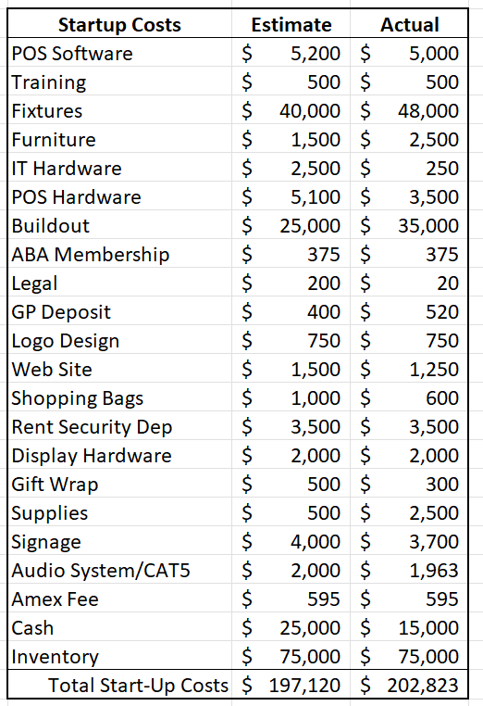
A Real-World Example: Estimated Upfront or Startup Costs for a New Bookstore:

Slide 9
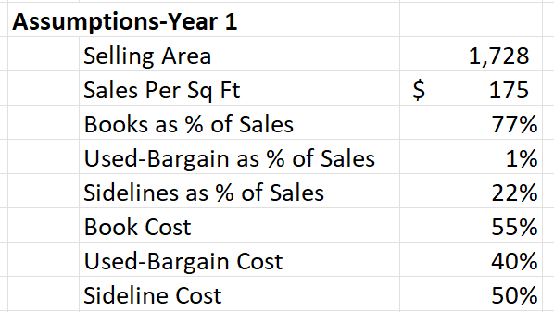
A Real-World Example: Assumptions Used to Estimating Benefits (Operating Profits) for a New Bookstore:

Slide 10
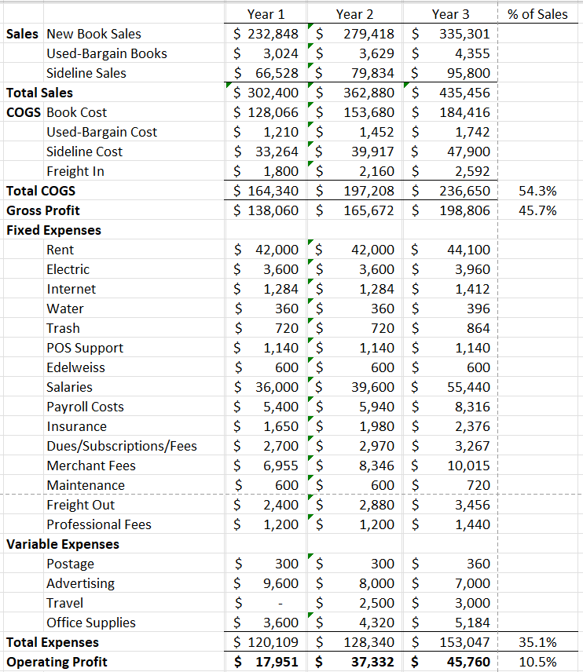
A Real-World Example: Increase in Operating Profits

Slide 11
Cost/Benefit Analysis: Key Performance Measures
1. Net Present Value (NPV)
NPV = PV of Benefits – PV of Costs
NPV Measures the Expected Wealth Created/Destroyed
2. Internal Rate of Return (IRR)
IRR Equals the Expected Annual Rate of Return
Is the Expected IRR > Required Return?

Slide 12
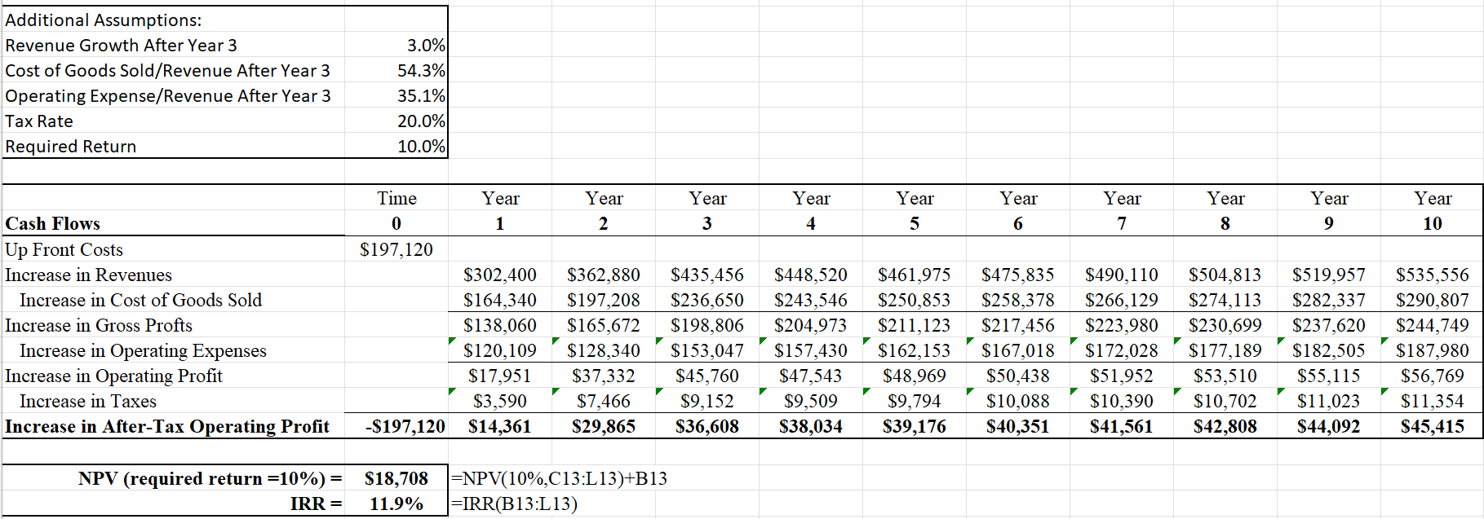
Cost/Benefit Analysis for a New Bookstore: 10-Year Life

Slide 13
Implication of Cost/Benefit Analysis for New Bookstore
Based on our assumptions, the expected NPV is $18,708 suggesting that the benefits are expected to be greater than the costs and the investment is expected to be value enhancing.
Additionally, the expected rate of return or the IRR is 11.39%/year, since the expected rate of return is greater than the required rate of return (10%) then this investment is expected to earn abnormally high returns and this investment is expected to be value enhancing.
How certain are we that this is a value enhancing investment?

Slide 14
Risk Assessment
How Certain Are We That This is a Value Enhancing Investment?
What If We Do Not Operate the Store for the Full 10 Years?
What If Our Revenue Growth is Not as Fast as We Assumed?
What If Our Operating Margins are Not as Strong as Assumed?

Slide 15
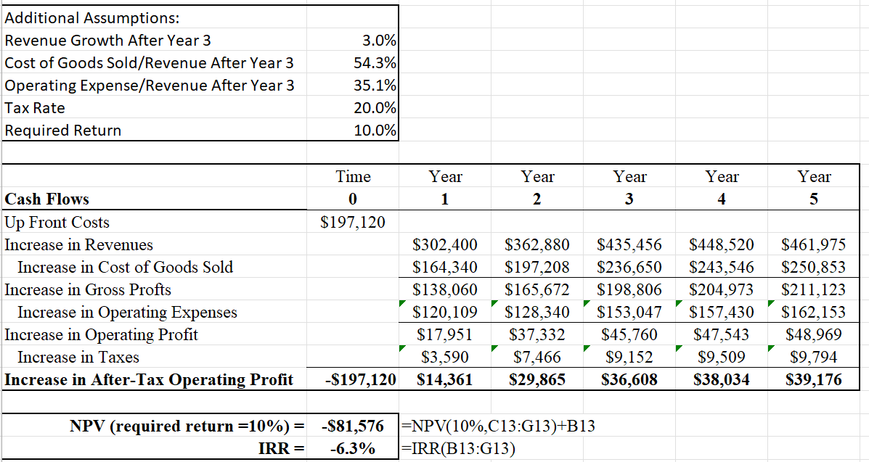
Cost/Benefit Analysis for a New Bookstore:– 5-Year Life

Slide 16
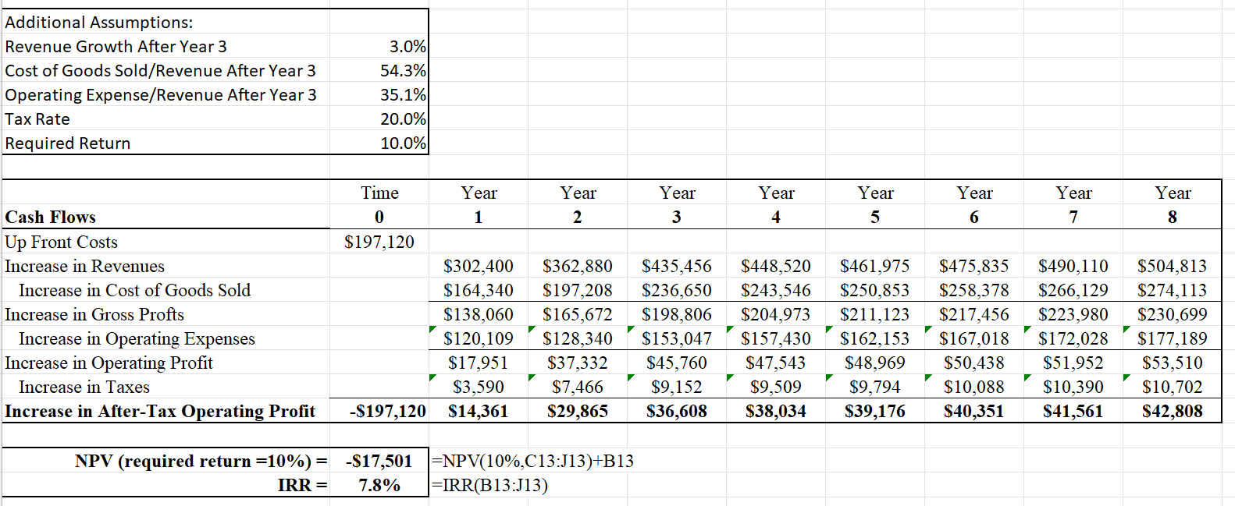
Cost/Benefit Analysis for a New Bookstore: 8-Year Life

Slide 17
Implication of Risk Assessment Based on the Investment’s Horizon
Results: If we assume the bookstore will be in operations for only 8 years instead of the full 10 years, the expected NPV became a -$17,501 and the IRR is expected to equal 7.8% both suggesting this new bookstore would be a value destroying investment.
These results suggest that a small change in the investment’s horizon (from 10 to 8 years) the expected benefits are no longer expected to be greater than the expected upfront costs.
Implication: This is a Risky Investment and is Not Clearly a Value Enhancing Investment.

Slide 18
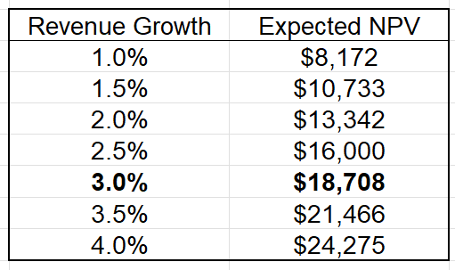
What if Revenue Growth is not as Strong as we Assumed?
Implication: This Appears to be a Low-Risk Investment as the Outcome is Not Very Sensitive to Changes in Revenue Growth.

Slide 19
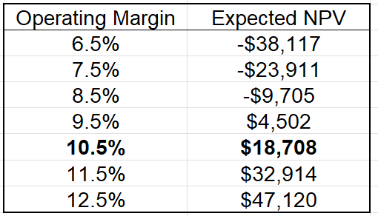
What if our Operating Margins are not as Strong as Assumed?
Implication: This Appears to be a High-Risk Investment as the Outcome is Very Sensitive to Changes in Operating Margin.

Slide 20
New Bookstore Example: Making A Decision
Based on the Sensitivity Analysis Regarding the Forecast Horizon (10 Years) and the Forecasted Operating Margin (10.5%), it Appears that this is An Extremely Risky Investment that May Not be Value Enhancing.
Therefore, Based on the Financial Value Impact, I Would Not Recommend Investing.
However, If the Investors Believes this Investment will Increase Social or Personal Value then Investing Might Be A Good Decision.

Slide 21
THANK YOU!
If You Have Any Questions or Want Help With Your Analyses Feel Free to Contact Me At:
pbrous@seattleu.edu

