Slide 1
An Introduction to Researching and Writing Grants for Nonprofit and For-Profit Bookstores
Presented by: Brandon Lueken, Director of Grant Development,
Bellevue College
Wednesday, Feb. 22 | Room 609 | 9:05 am to 10:05 am

Slide 2
PLEASE READ: Antitrust Guidelines
The booksellers in the room (virtual or otherwise) are, by definition, competitors. This means that under the law, they are prohibited from discussing certain things.
Specifically:
There can be no discussions of price or pricing policies. Competitors are never allowed to agree on the price at which merchandise is sold, or discounts at which merchandise is offered. All discussions of price and pricing policies are strictly off-limits.
There can be no discussion of boycotts. Competitors cannot agree to cease doing business with any supplier for any reason. Nor can competitors agree to urge consumers to boycott a third competitor. It’s collusion, and is strictly prohibited.
There can be no discussion of dividing up a market. For example, if there are two booksellers in New York City, they cannot agree that one will market only to consumers north of 57th Street while the other markets only to customers south of 57th street. This is also collusion and is prohibited.
All three of these prohibitions come to us via the Sherman Antitrust Act, which carries treble damages and jail time. All three are per se violations, which means it only has to be proved that you engaged in the activity—whether or not there was intent to harm, or actual harm caused—for you to be guilty of violating the law.

Slide 3
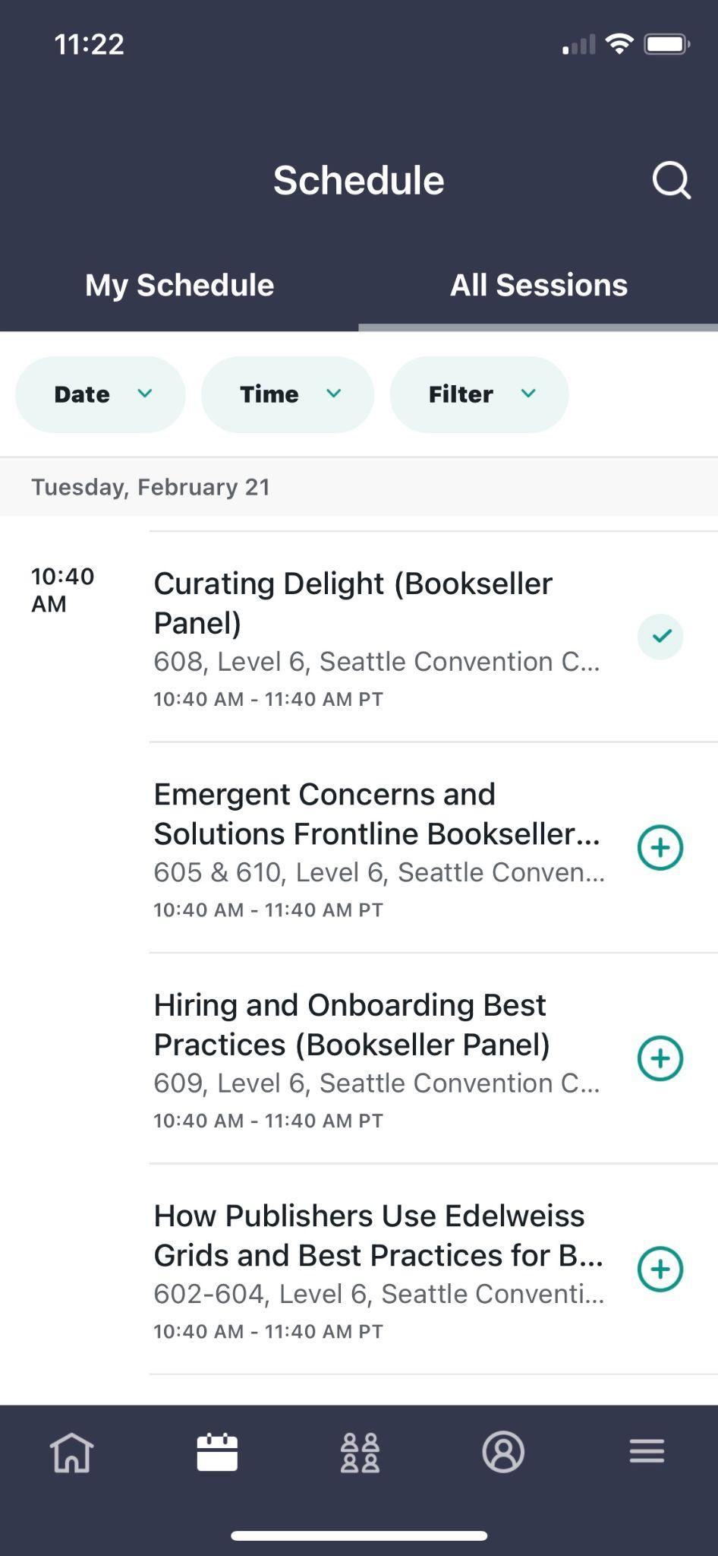
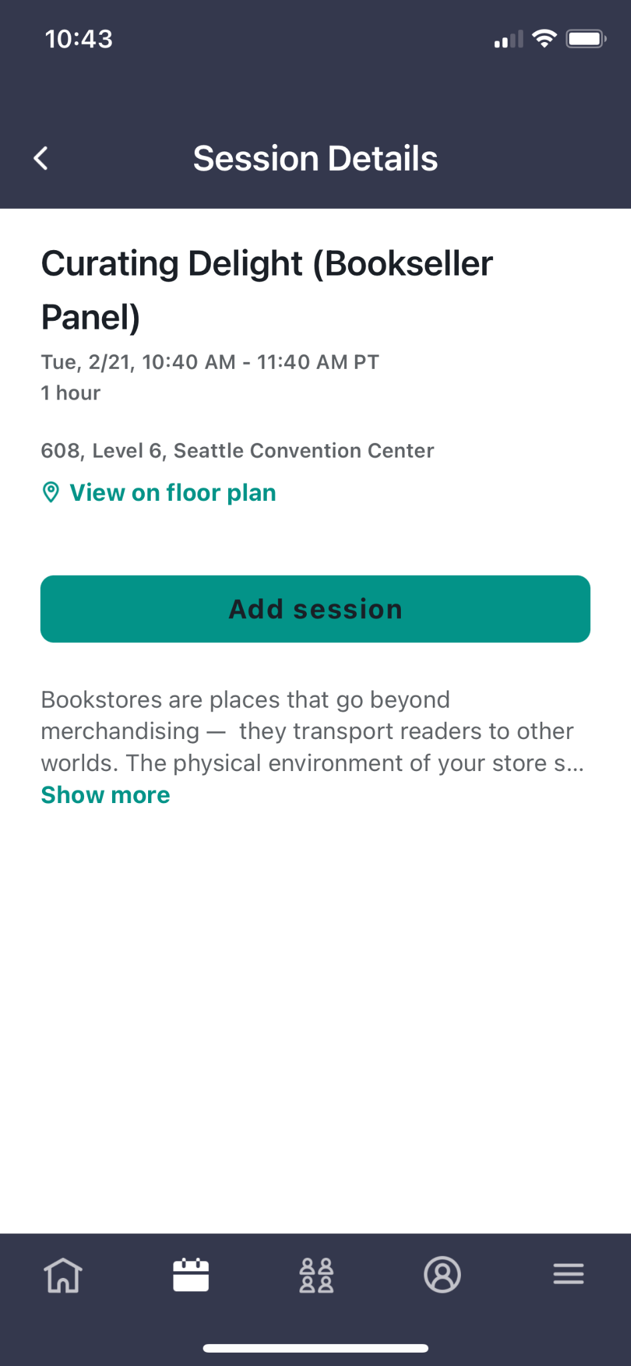
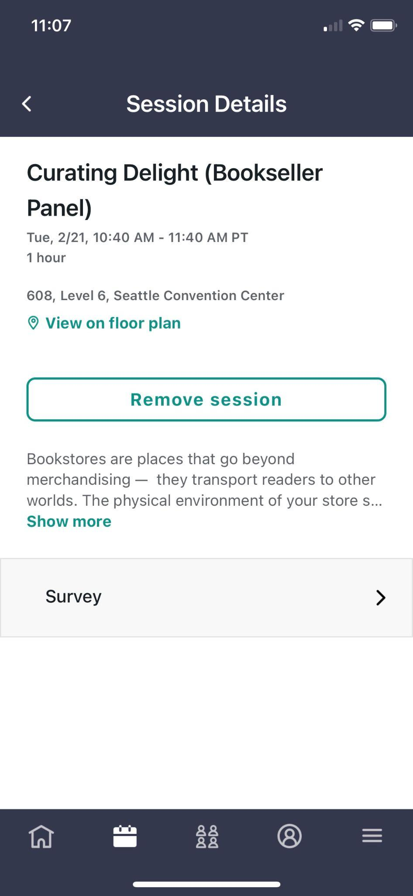
Evaluate the Session in the Winter Institute 2023 App
Find Session
Add Session
Rate Session

Slide 4
Who is this now?
Hello! My name is Brandon Lueken
Director of Grant Development at Bellevue College, the largest community and technical college in Washington State
Lifelong reader and frequenter of bookstores
English major, with an emphasis in creative writing
Writing grants since 2016
Board Member and Secretary of Puget Sound Grantwriters Association (PSGA)

Slide 5
Today’s Objectives
Understand what a grant is and how you apply for a grant
Become familiar with the services a grant writer offers
Develop a basic understanding of grant development and management
Get practice developing a case for funding
Notes:
-Outline expectations and objectives
-Be sure to ask questions as we go along

Slide 6

What is a grant anyway?
A grant is a contract between a funder (grantor) and another organization (grantee/fundee) to fulfill a project or program
Grants are NOT free money
Grants can fund specific projects, or they can fund general operating expenses - we’ll get into in a bit
Both for-profit and non-profit organizations can apply for grants
Notes:
Everybody loves free money! But grants are NOT free money. Grantors seek organizations who will “give legs” to their mission. That means grants typically are focused on project or programmatic activities and require achievement of defined outcomes. Good planning and consideration of impact on your infrastructure and other areas is critical.
Photo description: Scattered 100 dollar bills

Slide 7
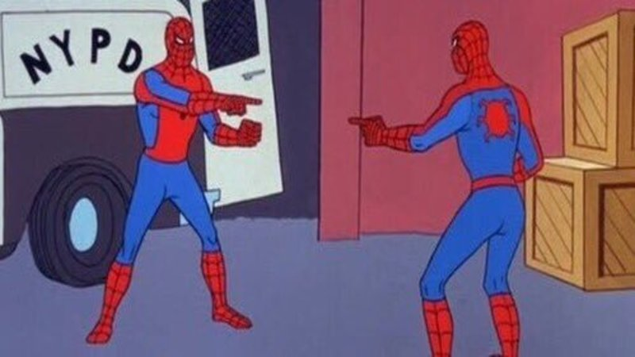
Alignment
Grant activities should be aligned with your organization’s priorities (mission & strategic plan)
Proposed activities must then align with the funder’s priorities
Try to match like with like – literacy projects for literacy funders, academic success project for academic funders
Projects with weak alignment stand less of a chance of receiving funding
Notes:
The BEST scenario is to find a grant that funds work that will achieve outcomes that have already been identified as priorities.
Photo description: Identical versions of Spiderman pointing at one another

Slide 8

Avoid the Money Chase (or Catch-22)
It can be tempting to alter your activities to pursue funding opportunities
If the activities are very new to your business, then this is called the Money Chase
Don’t Do It
WHY: You are changing your organization’s priorities and operations for hypothetical money (rather than money in hand)
Notes:
Photo Description: The book cover of Catch-22, by Joseph Heller

Slide 9
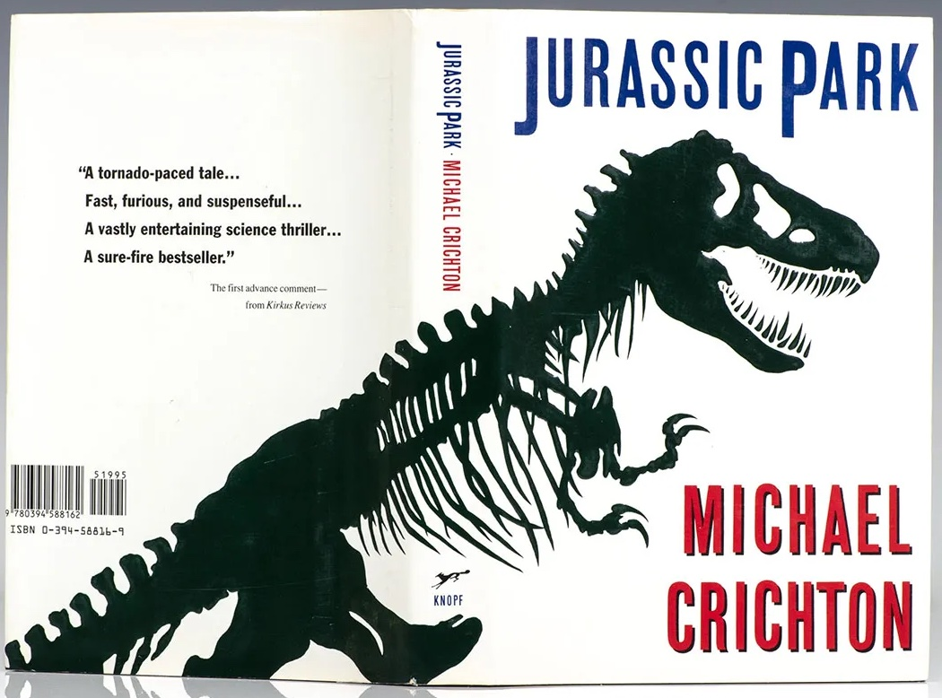
Grants Are Based on Outcomes
Grantors expect to see tangible, measurable outcomes
For example:
  Increase in childhood literacy
  Increase in civic engagement
  Resurrecting extinct species
Notes:
While we may see money, grantors expect to see tangible outcomes, transformation that can be measured
Photo description: The cover of Michael Crichton’s Jurassic Park

Slide 10

Beginning Your Grant Idea
You have an idea that is aligned and needs resources, but what next?
Put your idea in writing:
  What is the need or outcome you are trying to address?
  How are you going to meet that need or outcome?
You are building the ‘case’ for funding
Notes:
So you have an idea that you’d like to find resources for, where do you begin? Put your idea in writing. What is the need you have identified? What would you like to do to meet that need? This is about developing a case. Photo description: A drawing of a man, often seen in Ikea furniture instructions, with an open box, a set of instructions, and a bubble with a question mark above his head. Like many grant seekers, he is confused about where to start.

Slide 11
What does a Grant Writer do?
Advance the mission and strategic direction of the organization through grant acquisition
Advise on potential grant opportunities
Research for funding opportunities
Analyze and interpret funder guidelines
Collaborate on and manage grant development with stakeholders and external partners
Coordinate submission
Notes:
-Things the Grants Writers does not do: write the entire proposal for you, work miracles, act as a money fairy.

Slide 12
Other Things Grant Writers or Consultants Do
Help you become “grant-ready”
This may include registering for specific platforms like Grants.gov, the System for Award Management (SAM), or obtaining an Unique Entity Identifier (UEI)
  These are all separate from your business license or federal employer ID
Review finances or connect you to an auditor
  Some private grantors require you submit audited financials
  Many grantors will want to know your organizational budget, as well as a project-specific budget
  Some grantors may want to know who else you are requesting funding from, or your other fundraising goals

Slide 13



Where Do Grants Come From?
Local Government (ex: City and County Arts funds)
Private/ Corporate Foundations (ex: US Bank Foundation, Chamber of Commerces, family foundations )
Private and Family Foundations often can only give to 501(c)3 non-profit organizations
BINC – Book Industry Charitable Foundation (for book sellers)
Federal Government (ex: Dept. of Education, Dept. of Commerce, National Endowment for the Arts)
State Government (ex: State Arts Funds)
Notes:
-Grants come from the Federal Government, which identifies priorities for the nation, directions that reflects policy pushes. Some of the funding is political
-State Government: Same notion, reflects state priorities about budgets, can also have federal money pass through to state grants like BFET. A lot of Economic and Workforce Development funds come from the State of WA.
-Local government funds tend to be smaller (reflects local tax base): the funds we tend to go for are very arts focused.
Private Foundations run the gamut, they can be small amounts of money, or large, can have very specific interests, or very broad. Many tend to have pet projects and funders, but we can cultivate relationships.
BINC

Slide 14
Places to Find Grants
Grants.gov - the federal hub for grants
Foundation Center Online (also known as Candid)
  Has a monthly or yearly option, lowest cost is $35.54/mo.
  Your public library may have subscriptions that you can take advantage of
Grant Station
  $219/quarter (3 months)
  $699/year
City, County, and Chamber of Commerce grants will be located on their respective websites
And of course Google

Slide 15
What can a grant fund?
Bad ideas for a grant
General operating funds (payroll, rent, utilities, etc.)
  Family and Corporate foundations, the Dept. of Commerce
For specific new projects (we’ll cover this in a bit)
For-profit bookstores can apply!
  The Dept. of Commerce and other federal organizations will allow private businesses to apply
  You may be required to provide a financial match
For-profit bookstores can also use a fiscal sponsor - 501(c)3 non-profit can accept funds, give them to your organization
Grants can fund building maintenance and upkeep, usually for historical buildings
  Family foundations, state, county, and city, and chamber of commerce may all fund those
Supplanting existing costs that you are comfortably paying
Big projects that will be difficult to sustain in the long term (giving each customer a goldfish when they purchase a book)
Galas, parties, or specific fundraisers

Slide 16
Developing Your Grant Application
Begin by reading the funder’s guidelines and make notes
Is the application very prescriptive or does it allow more freedom?
What attachments are necessary?
  Letters of commitment
  Resumes
What is the budget and how will it be spent?
Style guidelines like word count, page limits, font and font sizes, etc.

Slide 17
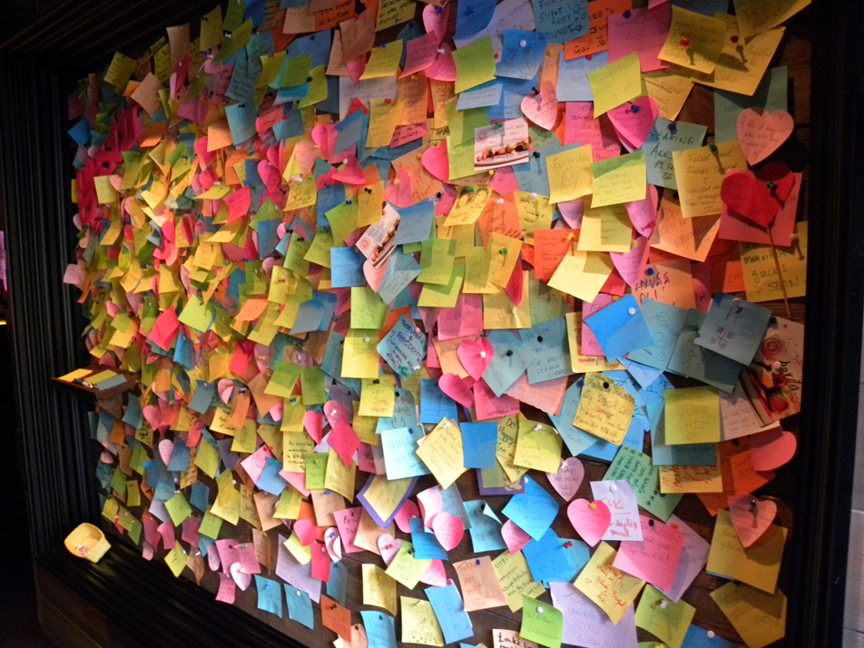
Grants Management
Notes:
Ah, grant management! It differs from grant to grant, but largely, it involves a lot of coordination and organization.
Photo description: a bulletin board covered with hundreds if not thousands of multicolored sticky notes in a visual mess.

Slide 18
Grant Management
So you have been awarded a GRANT! Congratulations!
Step 1: Notify the partners and stakeholders
Step 2: Read the Award Letter, re-read the proposal
Step 3: Get set to fulfill commitments and meet outcomes!
Grant reporting:
  Track data and info, submit reports according to grantor’s timeline
  Quality and timeliness of reports can affect future money

Slide 19
Potential Ideas for Book Store Grants
Literacy programs run by either the bookstore itself or in collaboration with non-profit organizations
Civic Engagement and pro-democracy efforts for adults
  As book clubs or something similar
Book Stores as event spaces for artists
Collaborating with a local artist to design your window displays
  It can help your foot traffic, your social media presence, and help an artist!

Slide 20
Case Development Activity
What is your idea? What do you need funding for?
Why does it matter? What does your idea bring to the organization?
How will you evaluate success?
Who is going to be a lead on the project?
How long will the project last? How will you manage the workload for that time?
How much will your idea cost?
Do you need to talk to anyone else (i.e. other organizations) to make your idea happen?

Slide 21
Thank you for joining!
Please complete the session evaluation in the app.

