Slide 1
Your Social Media Marketing Plan
Created by Christina Ciampa
Thursday, February 23 | Room 605 & 610 | 9:25 AM to 10:25 AM

Slide 2
PLEASE READ: Antitrust Guidelines
The booksellers in the room (virtual or otherwise) are, by definition, competitors. This means that under the law, they are prohibited from discussing certain things.
Specifically:
There can be no discussions of price or pricing policies. Competitors are never allowed to agree on the price at which merchandise is sold, or discounts at which merchandise is offered. All discussions of price and pricing policies are strictly off-limits.
There can be no discussion of boycotts. Competitors cannot agree to cease doing business with any supplier for any reason. Nor can competitors agree to urge consumers to boycott a third competitor. It’s collusion, and is strictly prohibited.
There can be no discussion of dividing up a market. For example, if there are two booksellers in New York City, they cannot agree that one will market only to consumers north of 57th Street while the other markets only to customers south of 57th street. This is also collusion and is prohibited.
All three of these prohibitions come to us via the Sherman Antitrust Act, which carries treble damages and jail time. All three are per se violations, which means it only has to be proved that you engaged in the activity—whether or not there was intent to harm, or actual harm caused—for you to be guilty of violating the law.

Slide 3
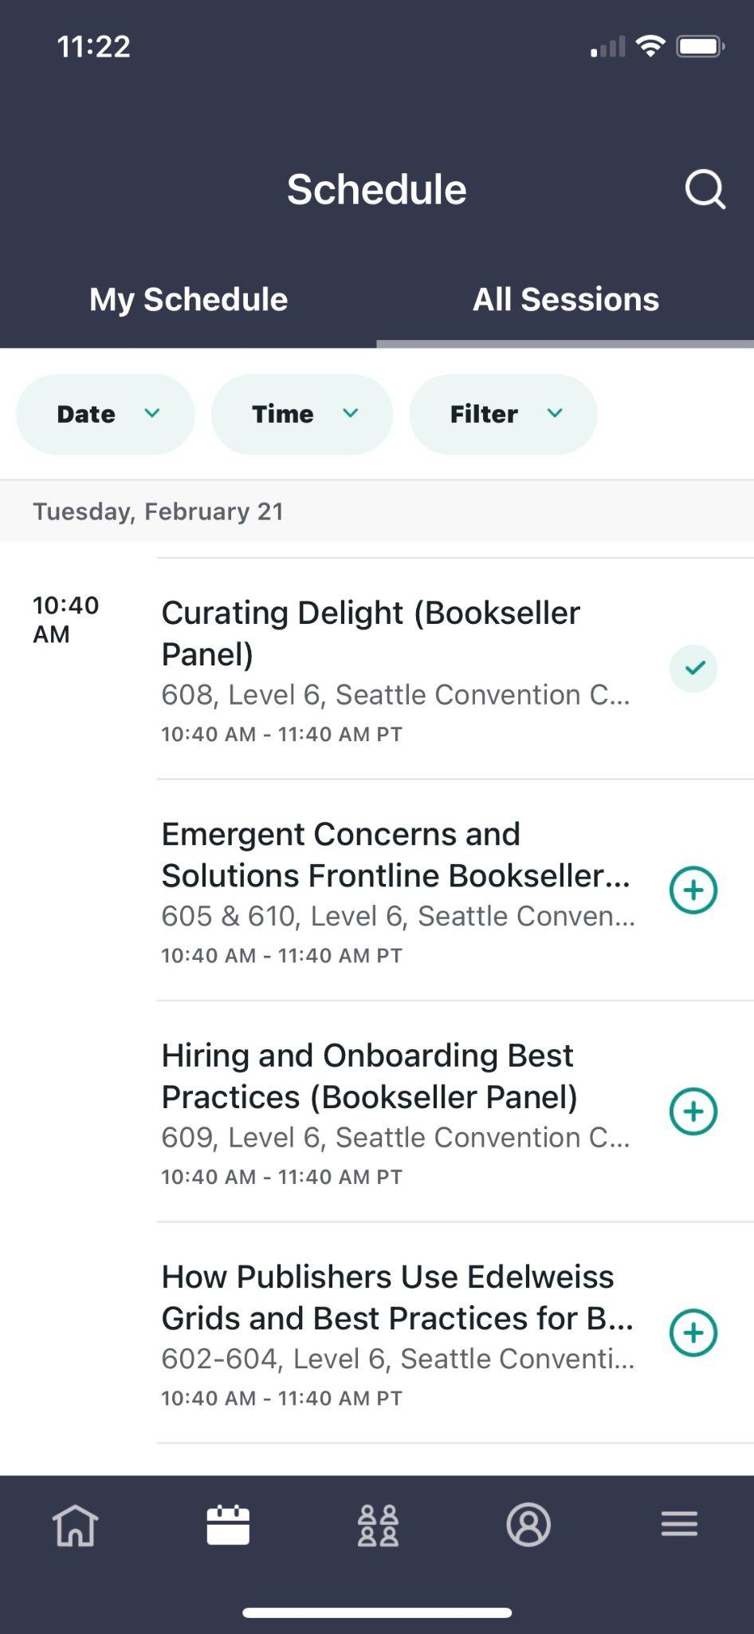
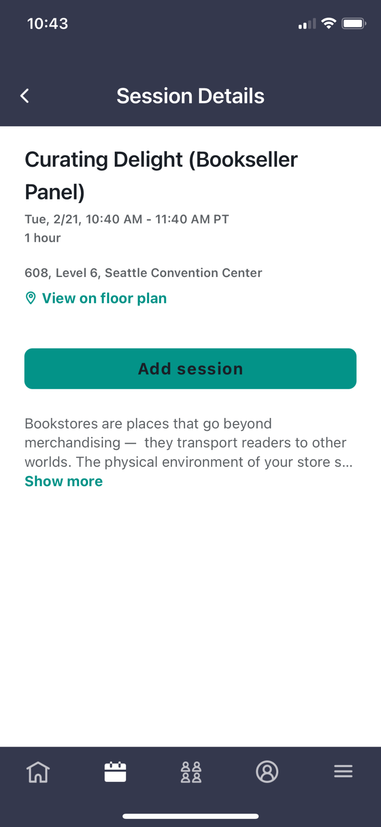
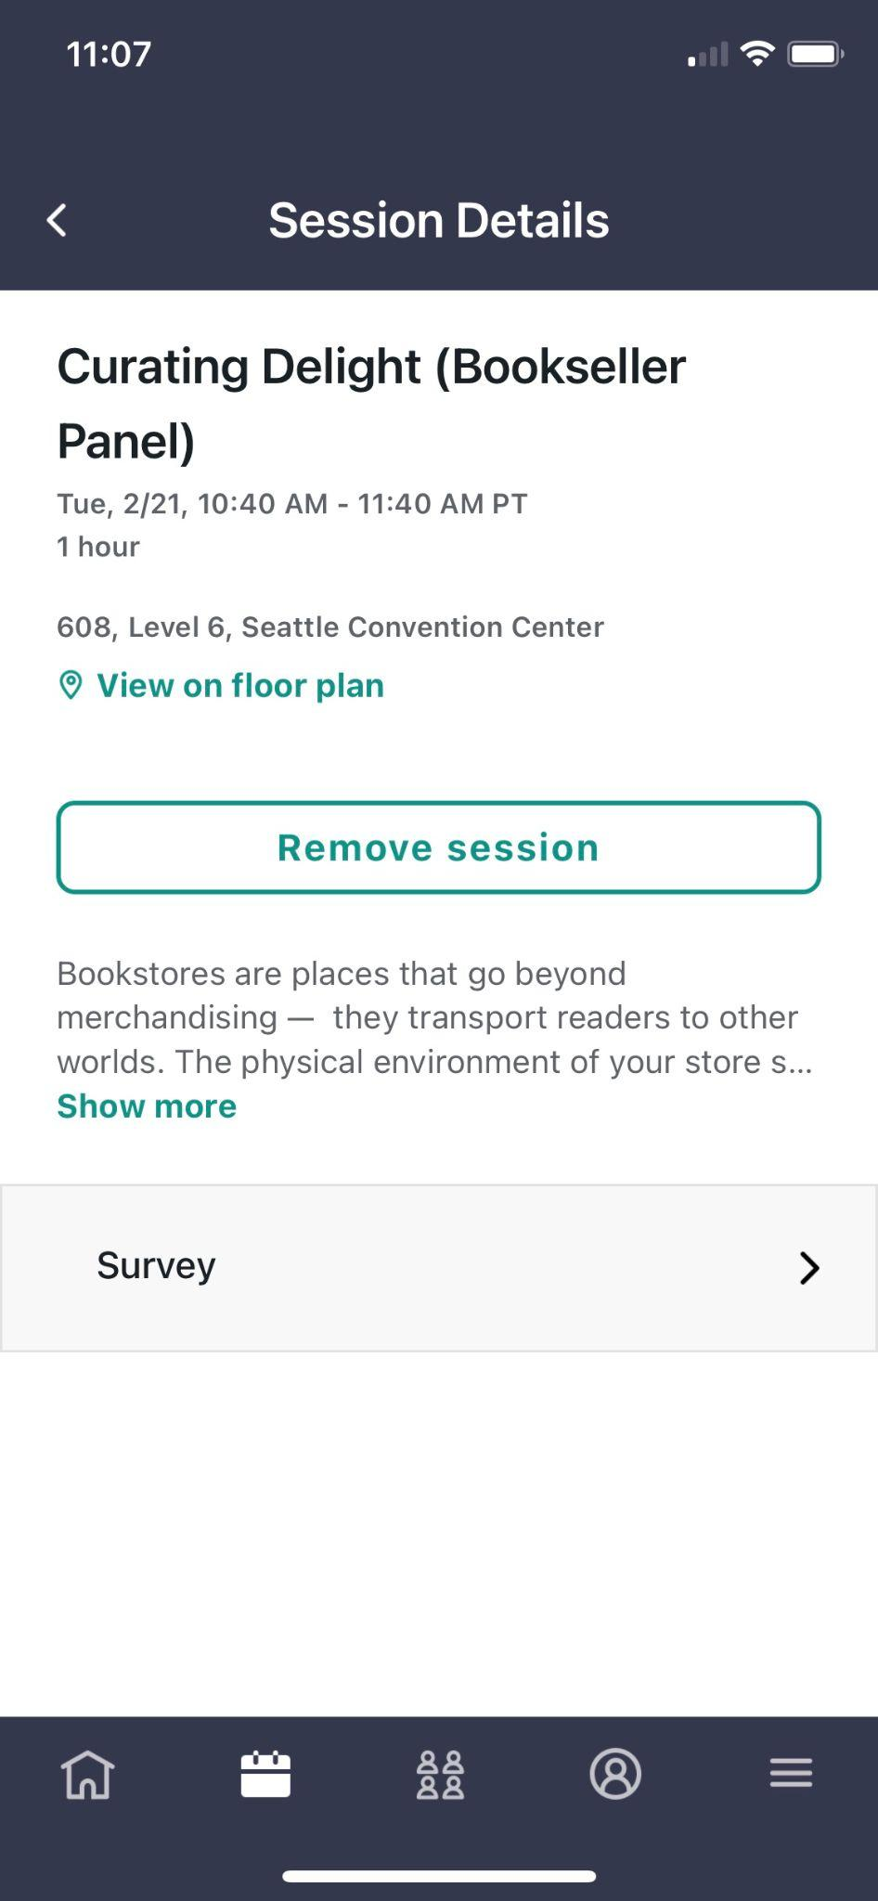
Evaluate the Session in the Winter Institute 2023 App
Find Session
Add Session
Rate Session

Slide 4
About
Business Objectives & Goals
Audience/Buyer Personas
Competitive Analysis
Social Listening
Social Media Audit
Metrics to Consider
Additional Data Tracking
Strategy/Tactics

Slide 5
Business Objectives & Goals
Business Objective | Social Media Goal | Metric(s)
Grow the Brand | Awareness (these metrics illuminate your current and potential audience) | Followers, shares, etc.
Turn customers into advocates | Engagement (these metrics show how audiences are interacting with your content) | Comments, likes, @mentions, etc.
Drive leads and sales | Conversions (these metrics demonstrate the effectiveness of your social engagement) | Website clicks, email signups, etc.
Improve customer retention | Consumer (these metrics reflect how active customers think and feel about your brand | Testimonials, social media sentiment, etc.
Notes:
Start developing a successful social media marketing plan by writing down at least three goals for social media.
It’s easy to get overwhelmed by deciding what to post and which metrics to track, but you need to focus on what you want to get out of social media to begin with. Don’t just start posting and tracking everything: match your goals to your business, and your metrics to your goals.

Slide 6
Audience/Buyer Personas
Suggested Details to Focus In On:
Age
Location
Language
Spending power and patterns
Interests*
Challenges*
Stage of life*
* These may be some details you must pay for on specific social platforms in order to see, or look to resource from other sources, but still important!
Notes:
Compile Audience Data from sources like Facebook, Google Analytics and even your own customer data base!
Messages and stories that resonate, generate interest, and engage customers in the journey!

Slide 7
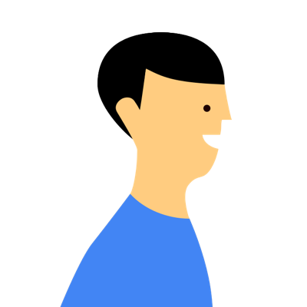
Buyer Personas
Impatient Lily
Ralph Reader
Researcher Abby
Suggestable Sam
Age 35-44. Lives less than 5 miles away from the bookstore. Easily frustrated and not afraid to speak their mind. Will ask you why the book price is not the same as what Amazon advertises for.
Age 18-25. Lives 5 miles away from bookstore.. Relies on #Booktalk to guide their tbr piles. Shops regularly online and in-store. Spends $100 + per month.
Age 45-54. Lives 7 miles away from the bookstore. Thoroughly researches the next book they want to read, seeks advice from family, friends and online review sites. Spends $50 per month.
Age 25-34. Lives 10 miles away. Doesn't have a preference for a specific channel. They take time to open up your emails, click through to your website. Keen to engage with staff and hear sales advice in-store. Spends $100s per month.

Slide 8
Competitive Analysis
Maybe one of your competitors is dominant on Facebook, for example, but has put little effort into Twitter or Instagram. You might want to focus on the social media platforms where your audience is underserved, rather than trying to win fans away from a dominant player.
Notes:
Make sure you aren’t ALWAYS comparing yourself to the competition — it can be a distraction. I’d say checking in on a monthly basis is healthy. Otherwise, focus on your own strategy and results.

Slide 9
Social Listening
Do searches of the competition’s company name, account handles, and other relevant keywords on social media. Find out what they’re sharing and what other people are saying about them. If they’re using influencer marketing, how much engagement do those campaigns earn them?

Slide 10
Social Media Audit

Slide 11
Social Media Audit
Questions to Ask
What’s working, and what’s not?
Who is engaging with you?
What are your most valuable partnerships?
Which networks does your target audience use?
How does your social media presence compare to the competition?
Notes:
Your audit should give you a clear picture of what purpose each of your social accounts serves. If the purpose of an account isn’t clear, think about whether it’s worth keeping.
To help you decide, ask yourself the following questions:
Is my audience here?
If so, how are they using this platform?
Can I use this account to help achieve my goals?
Asking these tough questions will keep your social media strategy focused.

Slide 12
Social Media Metrics to Consider Tracking

Slide 13
Awareness Metric: Growth Rate Percentage
Net New Followers
___________________ x 100 = Growth Rate Percentage
Total Audience
Notes:
Reach KPIs
Reach KPIs measure how many users come across your social channels. These users might only interact with the channel passively — reach and engagement are two different things. Think of reach as a quantity measurement — reach data demonstrates your existing and potential audience, growth over time and brand awareness.

Slide 14
Awareness Metric: Post Reach Percentage
Measure Post Reach
___________________ x 100 = Post Reach Percentage
Total Followers
Notes:
Measure Post Reach means different things across different platforms, but for FB and Instagram — the number of people who have seen your post. Different from impressions…

Slide 15
Engagement Metrics: Applause Rate
Total Approval Actions
___________________ x 100 = Applause Rate Percentage
Total Followers
Notes:
Approval actions are likes, saves, retweets, favoriting a post, etc.

Slide 16
Engagement Metrics: Average Engagement Rate
Total Likes, Comments,
and Share
___________________ x 100 = Average Engagement Rate
Total Followers
Notes:
Approval actions are likes, saves, retweets, favoriting a post, etc.

Slide 17
Engagement Metrics: Amplification Rate
Total Post Shares
___________________ x 100 = Amplification Rate Percentage
Total Followers
Notes:
This is the rate of your followers who are sharing your content with their own followers. This metric could include everything from shares and retweets, to repins and regrams. Basically, a high amplification rate shows that your followers want to be associated with your brand.

Slide 18
Conversion Metrics: Conversion Rate
Conversions
___________________ x 100 = Conversion Percentage Rate
Total Clicks
Notes:
This is the number of users who perform the actions outlined in your social media CTA (visit your website or landing page, subscribe to a mailing list, make a purchase, etc.) compared to the total number of clicks on that given post. A high conversion rate shows that your social media post delivered something valuable to your audience that made them act!

Slide 19
Conversion Metrics: Click-Through Rate (CTR)
Total Clicks
___________________ x 100 = CTR Percentage
Total Impressions
Notes:
CTR is the percentage of people who viewed your post and clicked on the CTA (call to action) it included. This provides insight into whether your content captures your audience’s attention and inspires them to act.

Slide 20
Additional Data Tracking

Slide 21
Instagram Performance
[Date range]
[Comparison date range]
Top performing post
[insert image and link here]
# of posts | Net Followers Gain/Loss | Total Likes | Bio Link Clicks | Story Views
Notes:
Instead of looking in each of the platforms, you could look to record the information all in one place!
Impressions. What this metric tells you: How many times your content is being seen. ...
Reach. ...
Engagements per follower. ...
Follower growth. ...
5. Comments received. ...
Most engaged hashtags. ...
Referral traffic. ...
Instagram Stories metrics.

Slide 22
Facebook Performance
[Date range]
[Comparison date range]
Top performing post
[insert image and link here]
# of posts | Net Followers Gain/Loss | Total Likes | Page Views | Video Views
Notes:
Engagement rate.
Reach.
Impressions.
Followers growth.
Click-Through Rate.
Cost per Conversion.
Cost per Thousand Impressions.
Best time to post.

Slide 23
Twitter Performance
[Date range]
[Comparison date range]
Top performing post
[insert image and link here]
# of posts | Net Followers Gain/Loss | Total Likes | Total Retweets | Engagement Rate
Notes:
Link clickthroughs.
Video views.
Impressions by time of day.
Top tweets.
Conversions.
Demographics.
Top mention.
Like rate.

Slide 24
YouTube Performance
[Date range]
[Comparison date range]
Top performing post
[insert image and link here]
# of posts | Net Followers Gain/Loss | Total Likes | Comments | Views
Notes:
Views.
Impressions.
Impressions Click-Through Rate.
Watch Time.
Average Percentage Viewed.
Average View Duration.
Returning Viewers.
Unique Viewers.

Slide 25
LinkedIn Performance
[Date range]
[Comparison date range]
Top performing post
[insert image and link here]
# of posts | Net Followers Gain/Loss | Total Likes | Total Shares | Page Views
Notes:
Engagement.
Reach.
Impressions.
Followers growth.
Clicks and click-through rate.
Video views.
Traffic metrics.
Demographics.

Slide 26
TikTok Performance
[Date range]
[Comparison date range]
Top performing TikTok
[insert screenshot and URL here]
# of TikToks | Net Followers Gain/Loss | Total Likes | Total Shares | Total Views | Total Comments
Notes:
Engagement Rate by Follower. ...
Engagement Total. ...
Hashtags per Video. ...
Monthly Follower Growth Rate. ...
Videos with Mentions. ...
Videos per Week. ...
Views per Follower. ...
Engagement.

Slide 27
Strategy/Tactics

Slide 28
List Out Strategies with Tactics Below
Example: Continue to Build Brand Awareness
Examples of Tactics
Leveraging a social media calendar will help bring content into one place
Feed the content monster
80/20 Rule
80% of your posts should inform, educate, or entertain your audience
20% can directly promote your brand
Determine frequency of posts across social media channels
Instagram (feed): 3-7 times per week
Facebook: 1-2 times per day
Twitter: 1-5 times per day
LinkedIn: 1-5 times per day
Look into listing our blog posts onto other 3rd party websites, link building, etc.

Slide 29
Q&A?

Slide 30
Interested in Hiring Christina?
Please ask ABA for contact information to get in touch with me!

Slide 31
Thank you for joining!
Please complete the session evaluation in the app.

