Slide 1
Presents
Mobile Optimized and Responsive Themes
Importance of mobile optimized websites
What to consider when you plan your website
Tools available to achieve your goals

Slide 2
Why your site should be mobile friendly
Google started rolling out their mobile first index
Why mobile first?
Consumer daily behavior
When will mobile first index fully roll out
Will the change impact the new search results now

Slide 3
5 areas in the daily use of a smartphone
A Spark
An urgent need
In-store assistant
Micro-productivity
Planning ahead
Source:https://www.thinkwithgoogle.com/consumer-insights/smartphone-productivity-tools/ (Dec 2017)

Slide 4
Why your site should be mobile friendly
When will mobile first index fully roll out
Will the change impact the new search results now

Slide 5
Google’s Search Console
Free tool
Manage and monitor your site’s presence in Google search results
Provides information about your site – queries, clicks, device used
Submit an XML sitemap
Connect with Google Analytics

Slide 6
What kind of information does search console provide?
Search Analytics
Clicks – number of visits to your site
Impressions – how often it appears in search but not clicked on
CTR – percentage of clicks divided by impressions
Position – average across all queries of the top most link position
Queries that your site appear for in search results
Type of device your users are using to get to your site

Slide 7
Example of Search Analytics in Search Console

Slide 8
Example of Search Analytics Based on Device

Slide 9
Connect Search Console query results with Google Analytics
Instructions on connecting Search Console and Google Analytics - https://support.google.com/analytics/answer/1308621?hl=en
Instructions for Google Analytics setup - http://bookweb.org/indiecommerce/google-analytics
Webinar on Google Analytics - http://bookweb.org/indiecommerce/april-7-2016-google-analytics

Slide 10
How to make your site mobile friendly
Use Responsive Web Design for your site
Serves the same HTML code on the same URL regardless of the users device
Can render the display differently based on the device (smartphone, desktop etc.)
There are two other methods
Dynamic serving: used the same URL but generate a different HTML code based on device
Separate URLs: used different URLs and different HTML code

Slide 11
How does responsive web design help make your site mobile friendly
Users can share and link to your content with one URL
Requires less time to maintain multiple pages for the same content
Requires no redirection, reduces load time
Saves resources as Googlebots only need to crawl your site once. This can indirectly help Google index more more content and keep it’s index fresh
Users are more likely to stay if they can read the page clearly without pinching/zooming

Slide 12
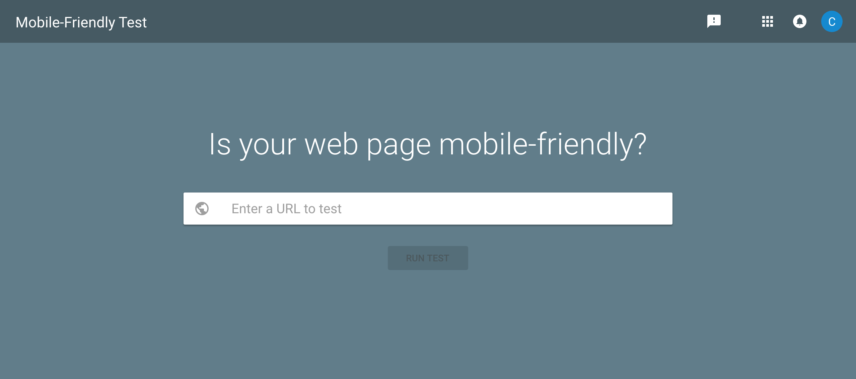
Google’s Mobile-Friendly Test Tool
https://search.google.com/test/mobile-friendly
Use the test tool to see if your site is mobile friendly

Slide 13
Is your site mobile friendly? Yes

Slide 14
Is your site mobile friendly? No

Slide 15
How to optimize your site for mobile
Choose a Responsive Theme
A theme that adapts to the device it is viewed upon.
Based on the Responsive Web Design
IndieCommerce list of Responsive themes can be found here - http://bookweb.org/indiecommerce/drupal-7-themes
Examples of sites using various Responsive themes can be found here - http://bookweb.org/indiecommerce/themes-used-live-d7-stores

Slide 16
Choosing a new theme
Make sure it is ‘responsive’
Color options
Slideshow
Social media icons
Available regions
Does it require advanced knowledge to configure
Drupal 7 Themes for IndieCommerce sites
Don’t choose a theme that is labeled –
THIS THEME IS NOT MOBILE FRIENDLY

Slide 17
Experiment with themes
Use ThemeKey
Allows you to work on a new theme without affecting the current theme
Change the theme only for your account
Instructions for setting up ThemeKey can be found on -
http://bookweb.org/indiecommerce/preparing-new-theme-using-themekey-0
Example: http://icsample20.d7.indiebound.com/

Slide 18
Is your site using a Responsive theme?

Slide 19
Make sure your content is mobile friendly
Already using a responsive theme but noticed some content doesn’t look good?

Slide 20
Optimize text for mobile viewing
Use text that is readable without zooming
Text on a page should be 12px or larger
Use high contrast – ex. use black text on a white background.
Use bullets points
Keep paragraphs short
Break up text with images
Use white space between paragraphs
Example - http://icsample17.d7.indiebound.com/about-us

Slide 21
Images
Upload the appropriate size for your content
Delete the width and height parameters from the settings
Add alternative text for each image
Example - http://icsample17.d7.indiebound.com/tips-responsive-images

Slide 22
Links
Place far enough apart so that the correct one can be easily pressed.

Slide 23
Footer
Place important links in the footer
Lessen the need to scroll back up
Example: http://icsample17.d7.indiebound.com/kids-indie-next-list

Slide 24
Avoid software not common on mobile
For example, Flash

Slide 25
Newsletter signup interstitial
Set it so it does not cover the whole screen
Google penalizes sites that have the popup cover the whole page
MailMunch - desktop and mobile display version
https://www.mailmunch.co/blog/google-punish-popups-mobile/

Slide 26
MailMunch Popup – Not Recommended

Slide 27
MailMunch Popup - Recommended

Slide 28
How consumers view and interact with email
Study conducted that surveyed 2,667 adults (18 and older)
3 in 5 Americans check email a few times a day
75% reported that they use their smartphones most often to check email
After viewing an email campaign, 26% visited the brands website or 26% made a purchase
Conversion from email by device – 50% mobile, 35% computers, 27% in-store
Source - Fluent’s Inbox Report: Consumer Perceptions of Email

Slide 29
Flexslider Slideshow
Flexslider
Views Slideshow
Examples -
http://icsample17.d7.indiebound.com/
http://icsample20.d7.indiebound.com/

Slide 30
Views Responsive Grid Module
Responsive Grid
Non Responsive
Example - http://icsample16.d7.indiebound.com/

Slide 31
Working with Tables
Less columns are better
Make sure you follow tips on images
Avoid if possible
Use the view responsive grid instead

Slide 32
Redesigning your site?

Slide 33
Think Mobile First
This doesn’t mean we ignore the desktop
Mobile display has limited space
Smaller viewport (screen)
Items are stacked
Prioritize important content

Slide 34
Visualize your site layout
Free online flowchart tool
https://www.draw.io/
http://icsample21.d7.indiebound.com/
Place relevant and important information at the top
Drupal themes have regions that will stack differently for each theme

Slide 35
Recommended stacking order
Above the fold or closer to the top – logo, store name, location, contact, hours of operation, main menu, social media, search
Top to middle area – upcoming events, curated booklist such as bestsellers, gift cards or other custom product, call to action
Footer – contact, help document, social media, newsletter, policy, location

Slide 36
IndieCommerce improvements to help make your site mobile friendly
ABA Indie Lists - Indie Next, Indie Kids, Reading Group, Indie Bestsellers
Browse/books page
Event Calendar - upcoming feature
Wish list
Responsive Booklist Grid (its called the Front Page Booklist module and will be enabled upon request)
Improve themes
Bamboo theme, Corolla and Responsive Green
Will continue to work to improve other themes
Added New Responsive themes
Zircon theme, United Zymphonies, Business Responsive

Slide 37
Test… test…test…
Go through your site on a mobile device
Tools for testing
Chrome Mobile View
FireFox Responsive Design View
Your own smartphone
Example - http://icsample20.d7.indiebound.com/

Slide 38
Thank you for joining us!

